Slide 1
UPDATE ON UTAH LAKE C, N, AND P PROJECT
Kateri Salk
2021-04-15

Slide 2
COMPONENTS
Quantification of conceptual model
External mass balance
SedFlux modeling

Slide 3
EXTERNAL MASS BALANCE COMPONENTS
Tributary loads: monitored watersheds
Tributary loads: unmonitored watersheds
Groundwater loads
Atmospheric loads → values from Brahney 2019 and ULWQS SP AD Loading Recommendation - Approved – Final
Jordan River outflow
Precipitation/Evaporation (for water balance) → values from EFDC/WASP output

Slide 4
EXTERNAL MASS BALANCE: DECISION POINTS
Focus today: tributary loads in monitored watersheds
2 Decision points:
Comparing DWQ and WFWQC data → use one or both entities?
For watersheds with WWTP, how to address DMR reported loads vs. tributary data?

Slide 5
Constituent | Method and Reporting Limit UDWQ | Method and Reporting Limit WFWQC
TP | EPA-NERL: 365.1: (4823) Phosphorus (all forms) by Semi-Automated Colorimetry 0.02 | Hach Co.: 8048: Orthophosphate by Colorimetry 0.021
TDP | EPA-NERL: 365.1: (4823) Phosphorus (all forms) by Semi-Automated Colorimetry 0.02 | Hach Co.: 8048: Orthophosphate by Colorimetry 0.021
TN | APHA 4500-N Persulfate Method for Total Nitrogen 0.2 | Hach Co.: 10242: (TNTplus 880) Simplified Spectrophotometric Measurement of TKN in Water and Wastewater 0.7
TDN | APHA 4500-N Persulfate Method for Total Nitrogen 0.2
TOC | APHA 5310 B Total Organic Carbon by Combustion-Infrared Method 0.5
DOC | APHA 5310 B Total Organic Carbon by Combustion-Infrared Method 0.5
Lowercase text

Slide 6
WATERSHEDS
Watersheds w/o WWTP, monitored by only UDWQ | Watersheds w/o WWTP, monitored by both UDWQ and WFWQC | Watersheds with WWTP
Tickville Wash | Lehi Spring Creek | Timp SSD (Timpanogos)
Dry Creek – Saratoga | American Fork River | Powell Slough Major (Orem)
Currant Creek | Lindon Drain | Mill Race (Provo)
 | Provo River | Spring Creek – Springville (Springville)
 | Hobble Creek | Dry Creek – Spanish Fork (Spanish Fork)
 | Spanish Fork River | Benjamin Slough (Payson, Salem)
 | 4000 South Drain Spanish Fork
Use values directly
Compare entities, use values from one or both
Compare entities + address potential for attenuation of WWTP loading

Slide 7
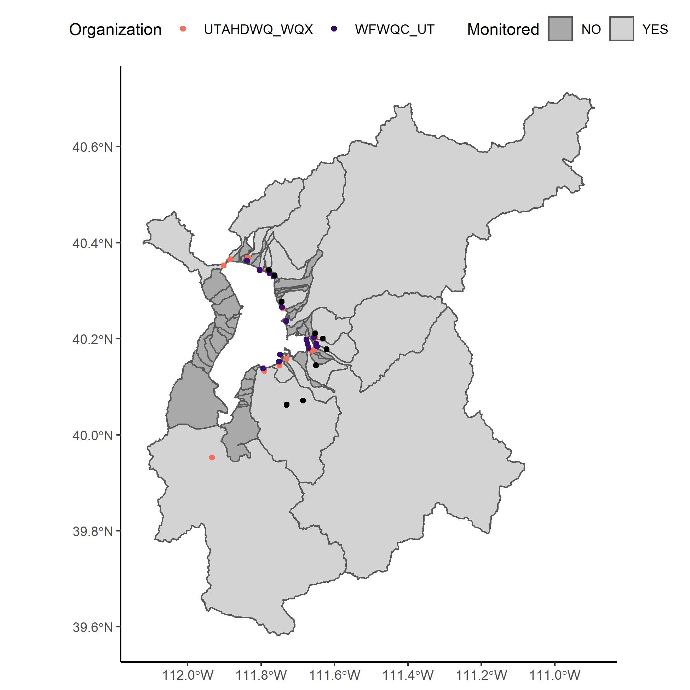
WATERSHEDS
UDWQ sites: orange
WFWQC sites: purple
Facility sites: black
Majority of watershed is monitored
Focus on these today
Unmonitored sites upcoming (paired watershed approach)

Slide 8
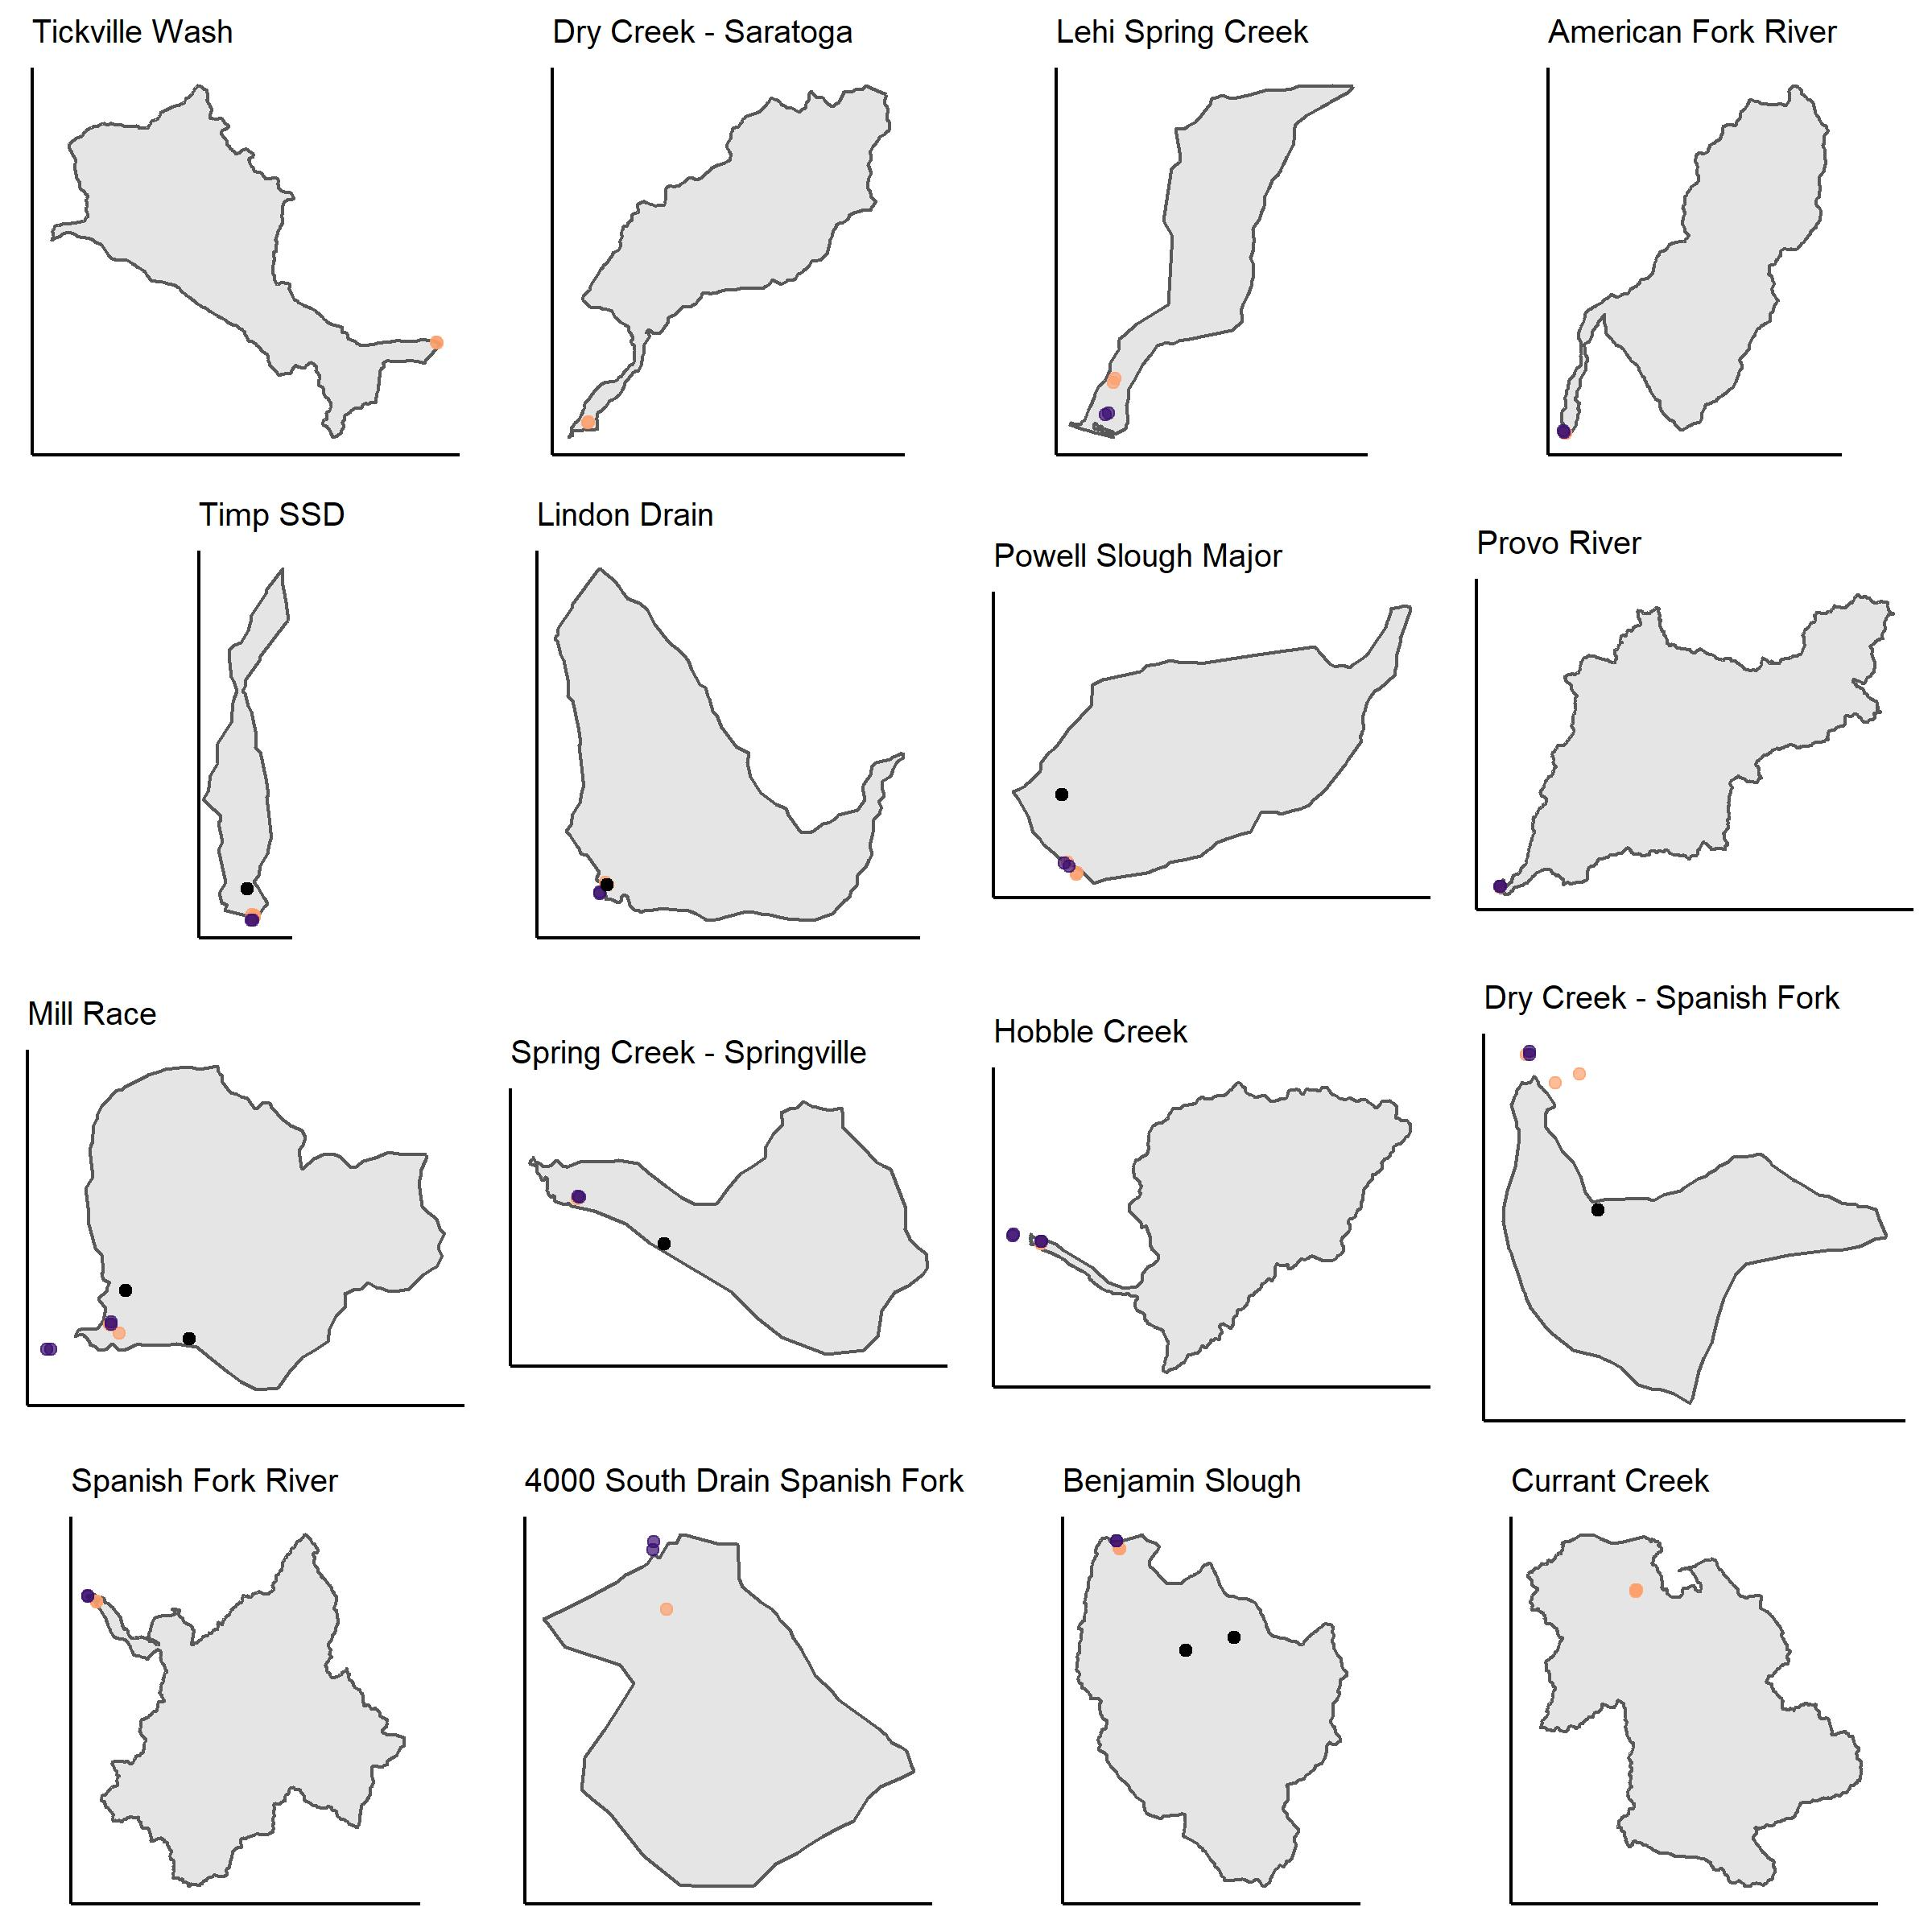
WATERSHEDS (NOT TO SCALE)
UDWQ sites: orange
WFWQC sites: purple
Facility sites: black
WFWQC sites are downstream or at the same location as UDWQ sites
Some sites are below the compromise elevation

Slide 9
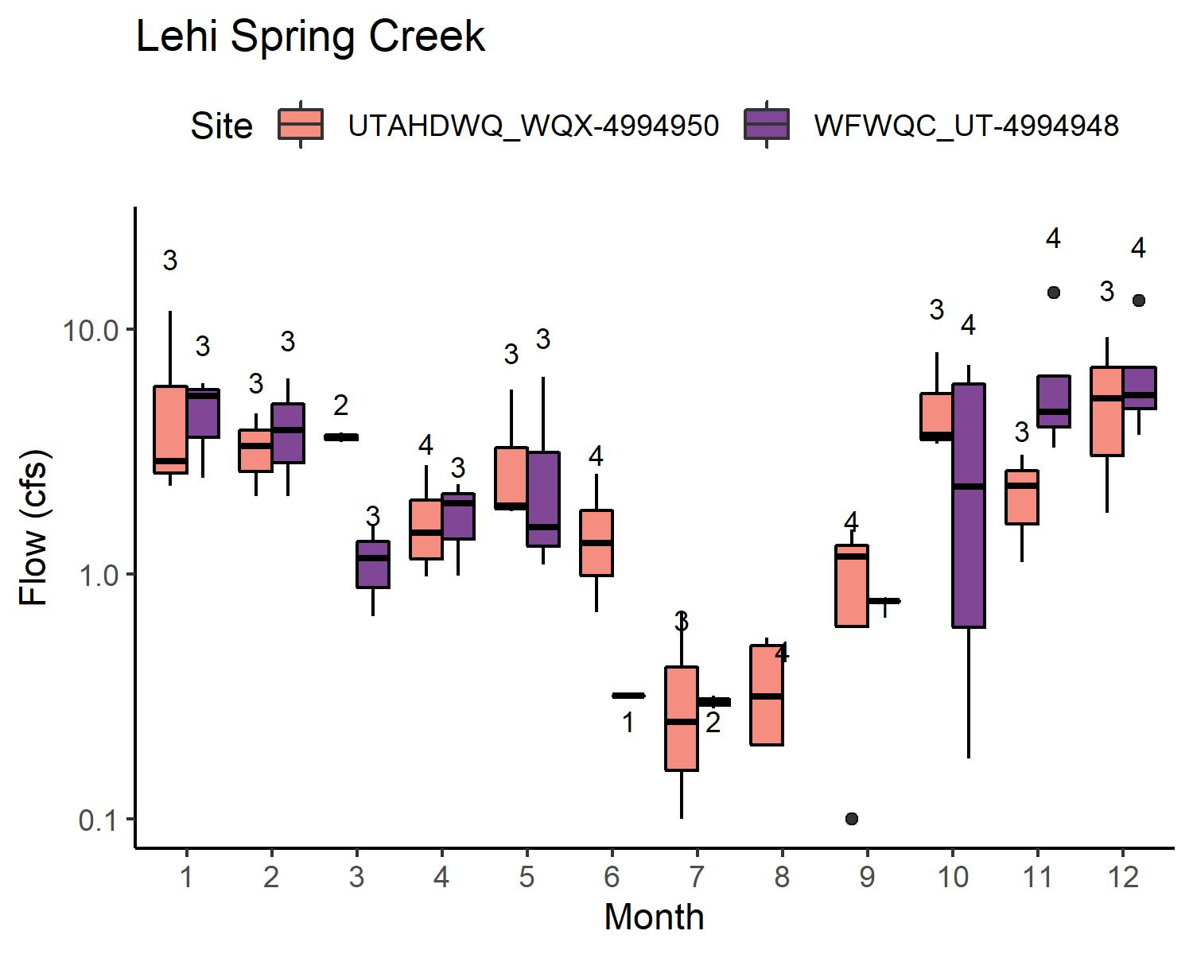
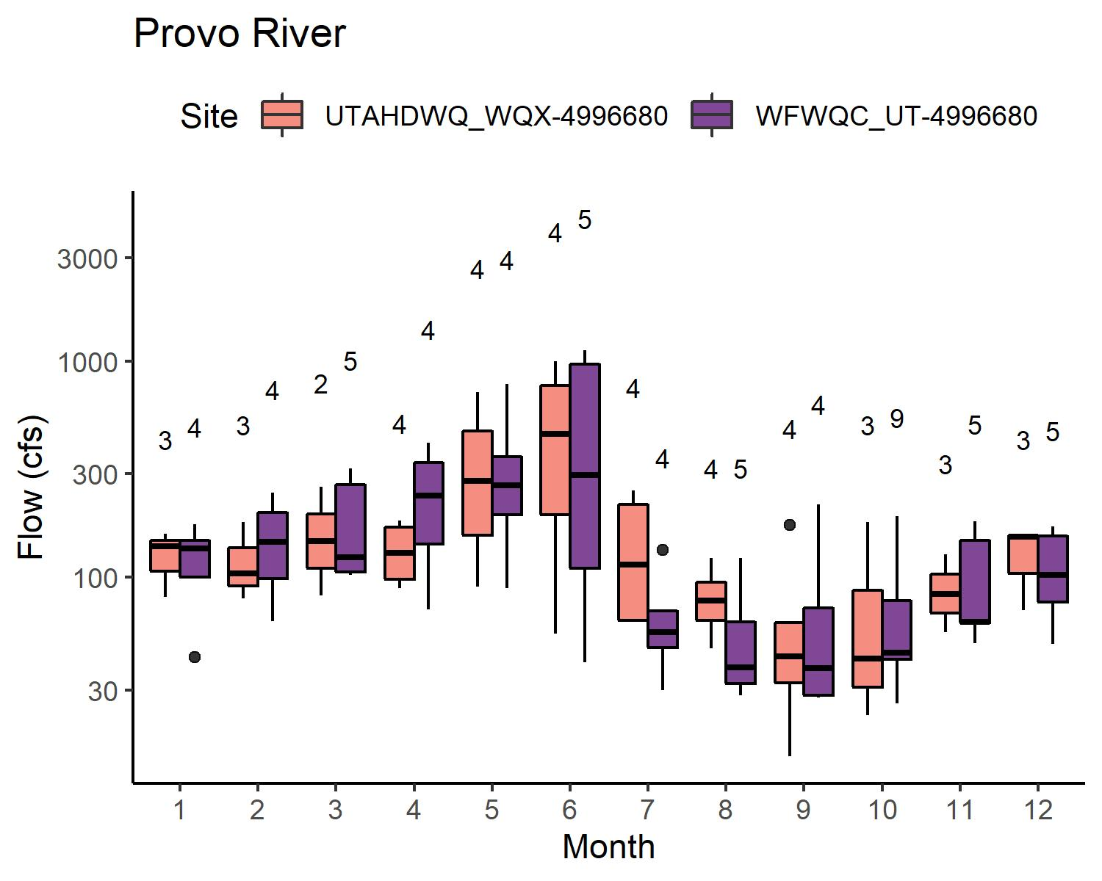
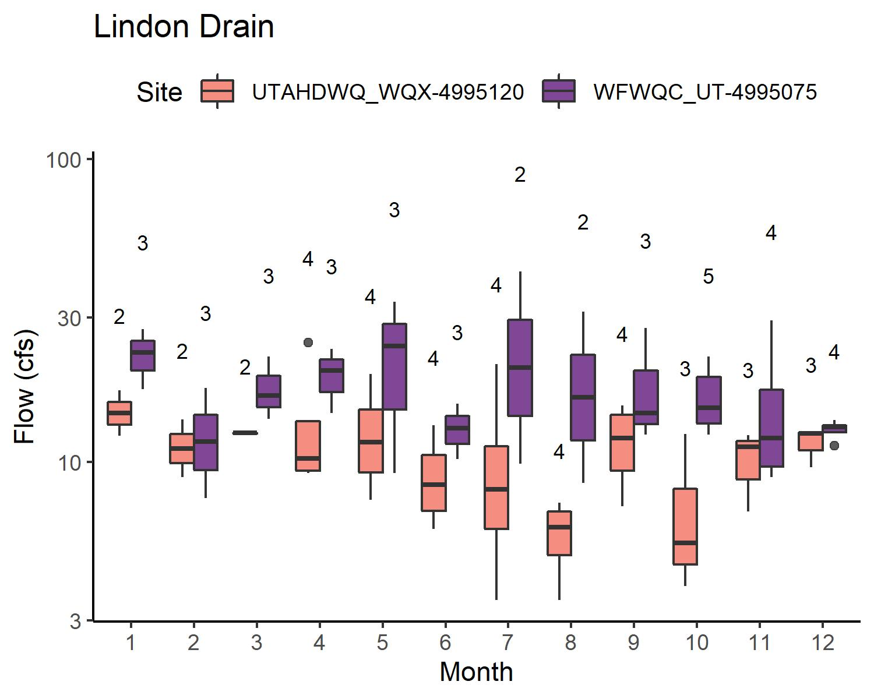
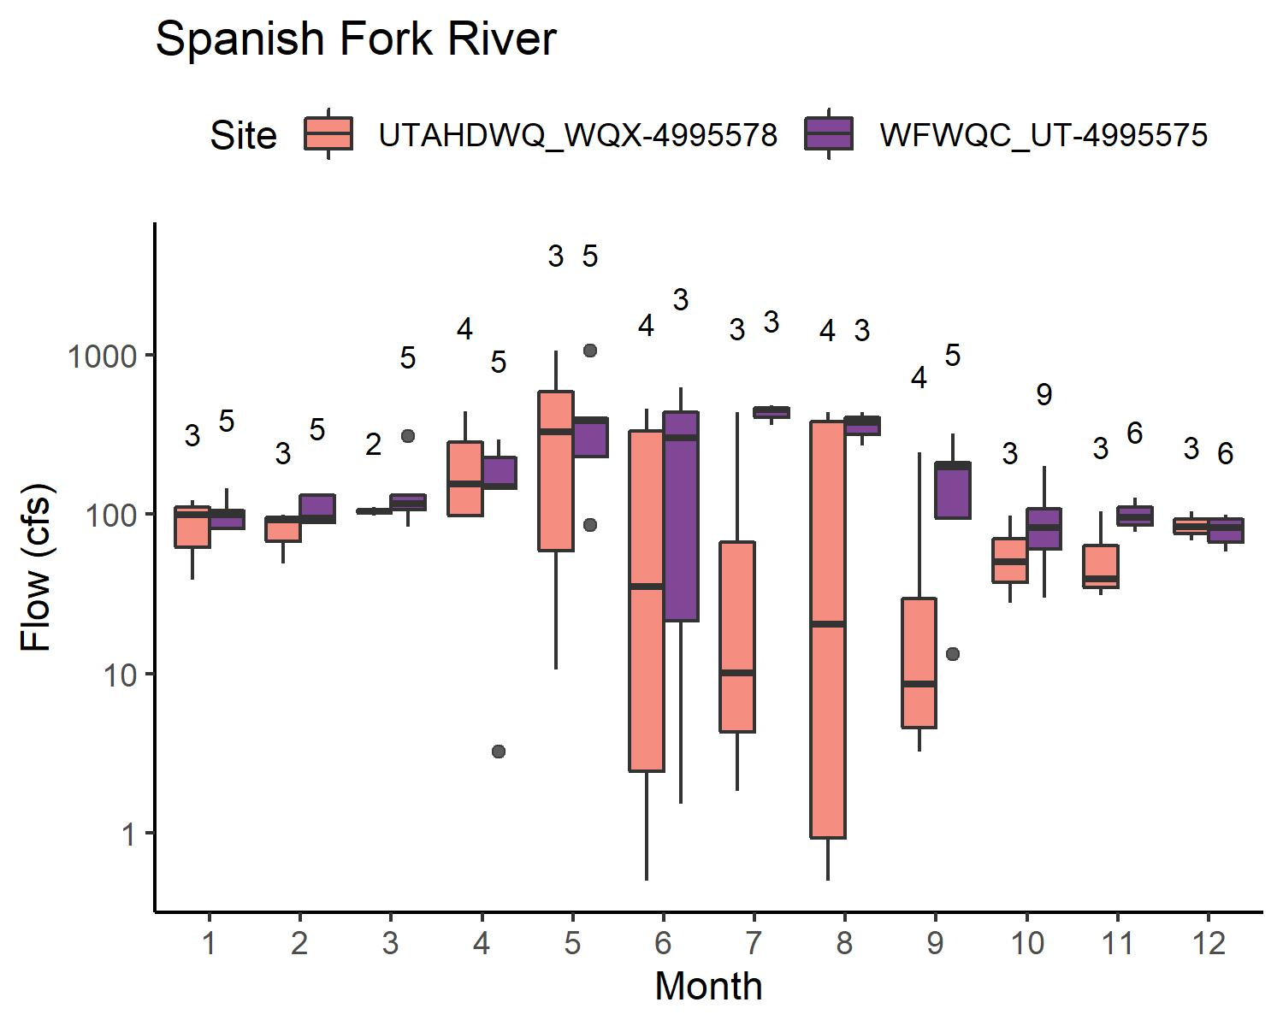
FLOW: WATERSHEDS W/O WWTP
Flow: UDWQ ≈ WFWQC
Lehi Spring Creek
American Fork River
Provo River
Hobble Creek
4000 South Drain Spanish Fork
Flow: UDWQ < WFWQC
Lindon Drain
Spanish Fork River

Slide 10
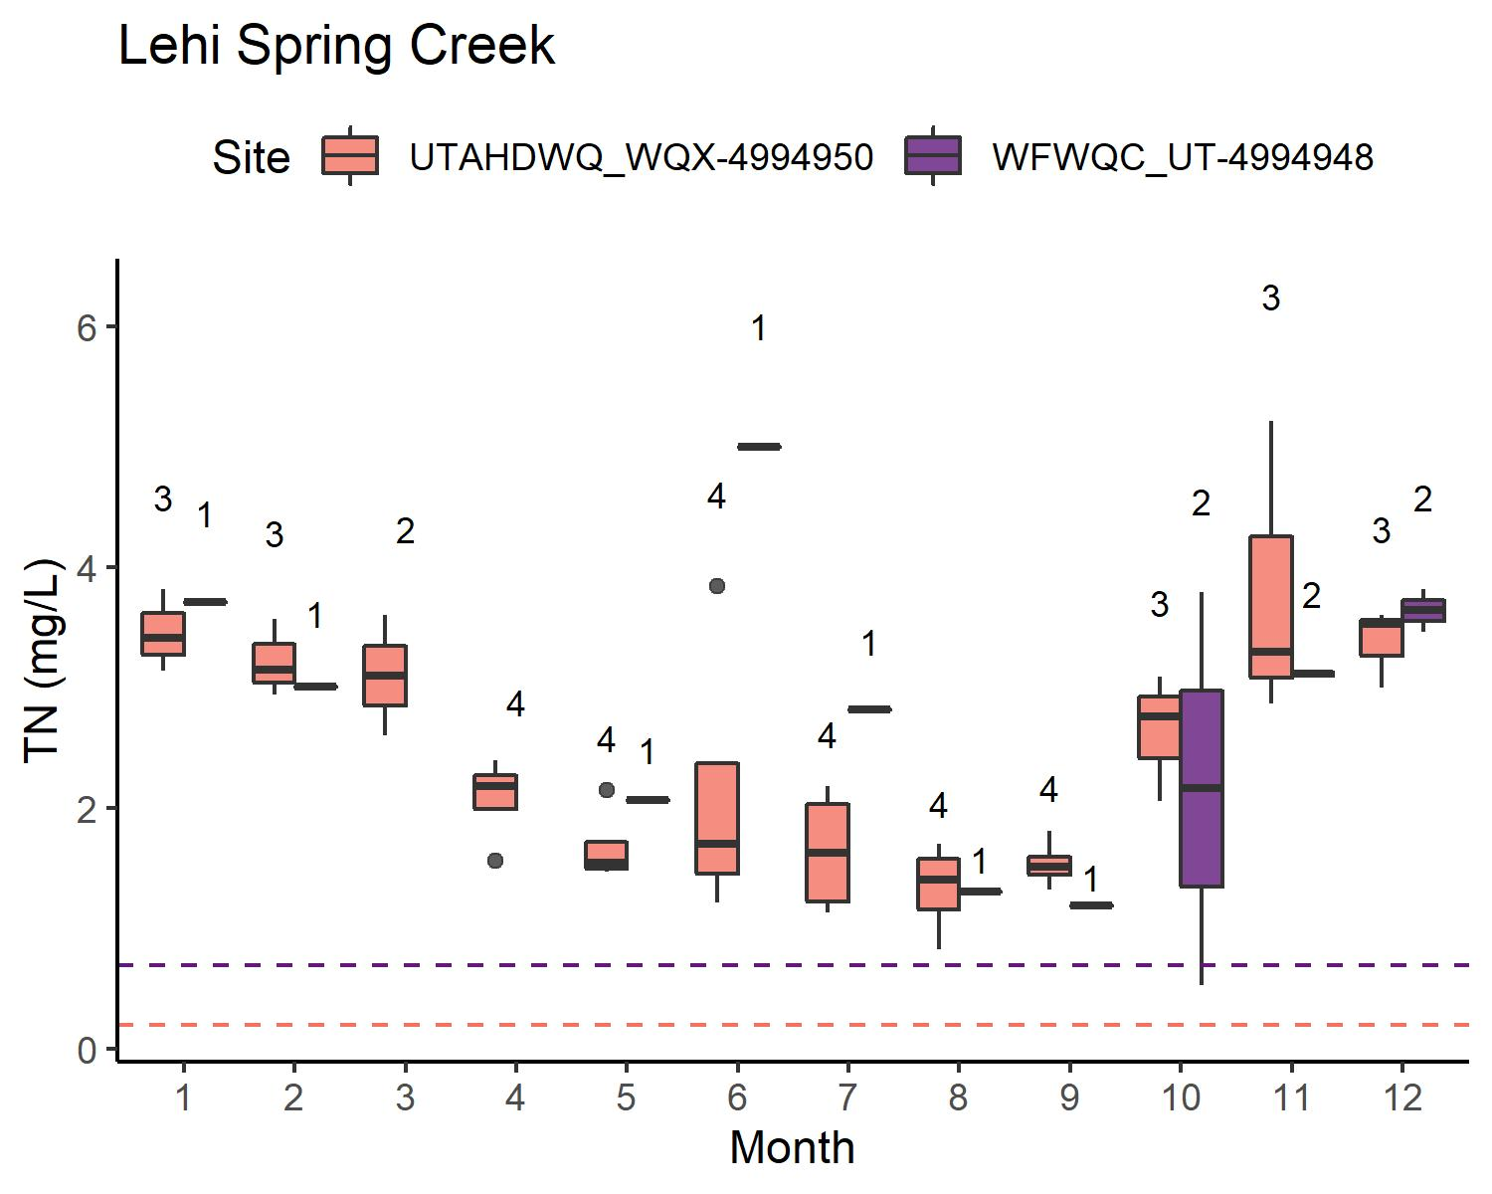
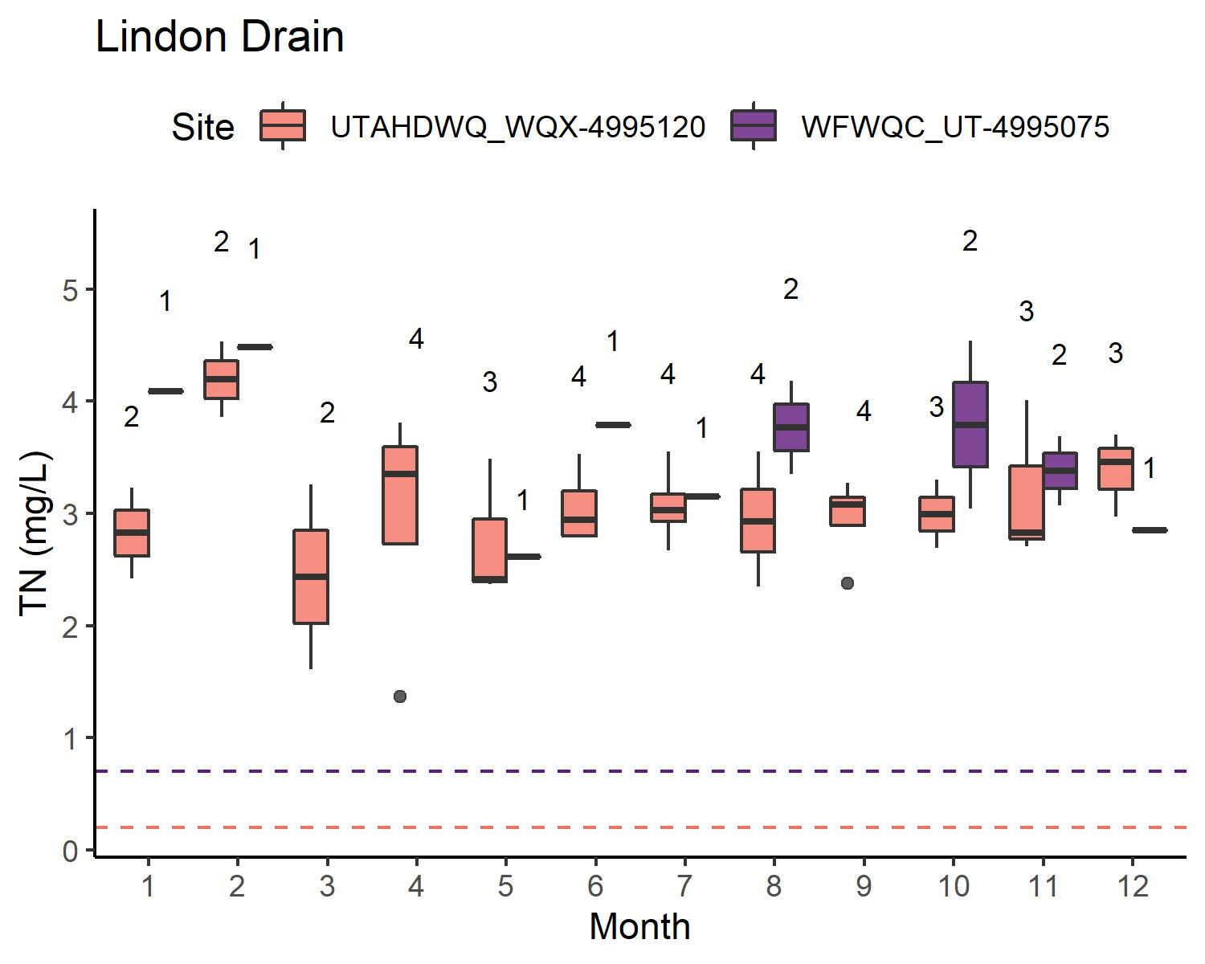
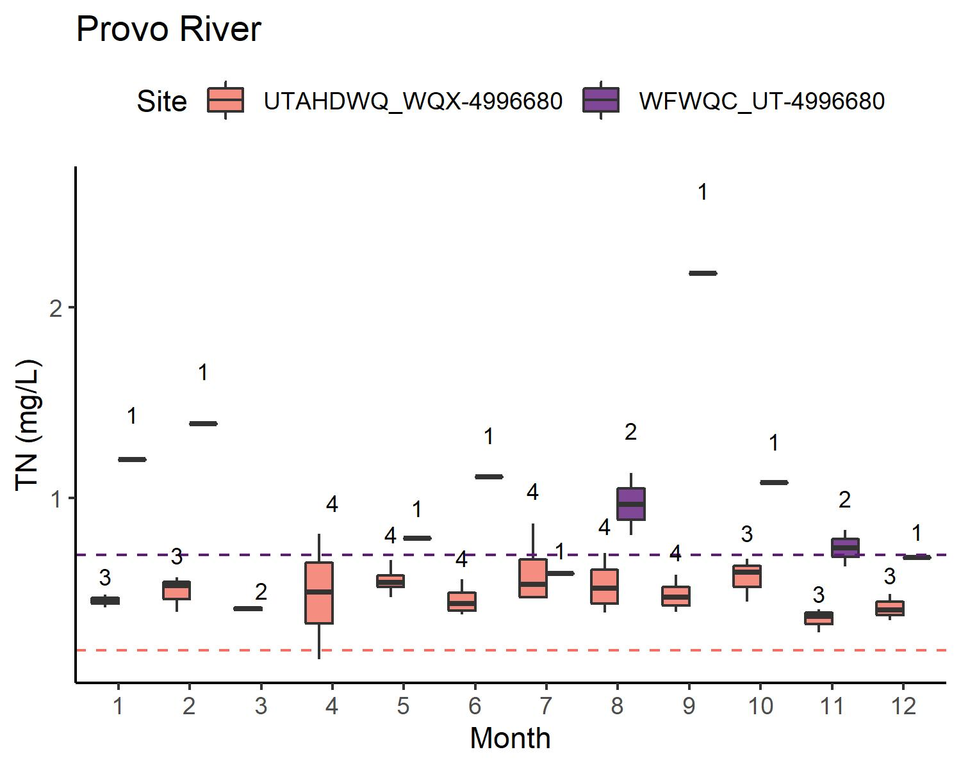
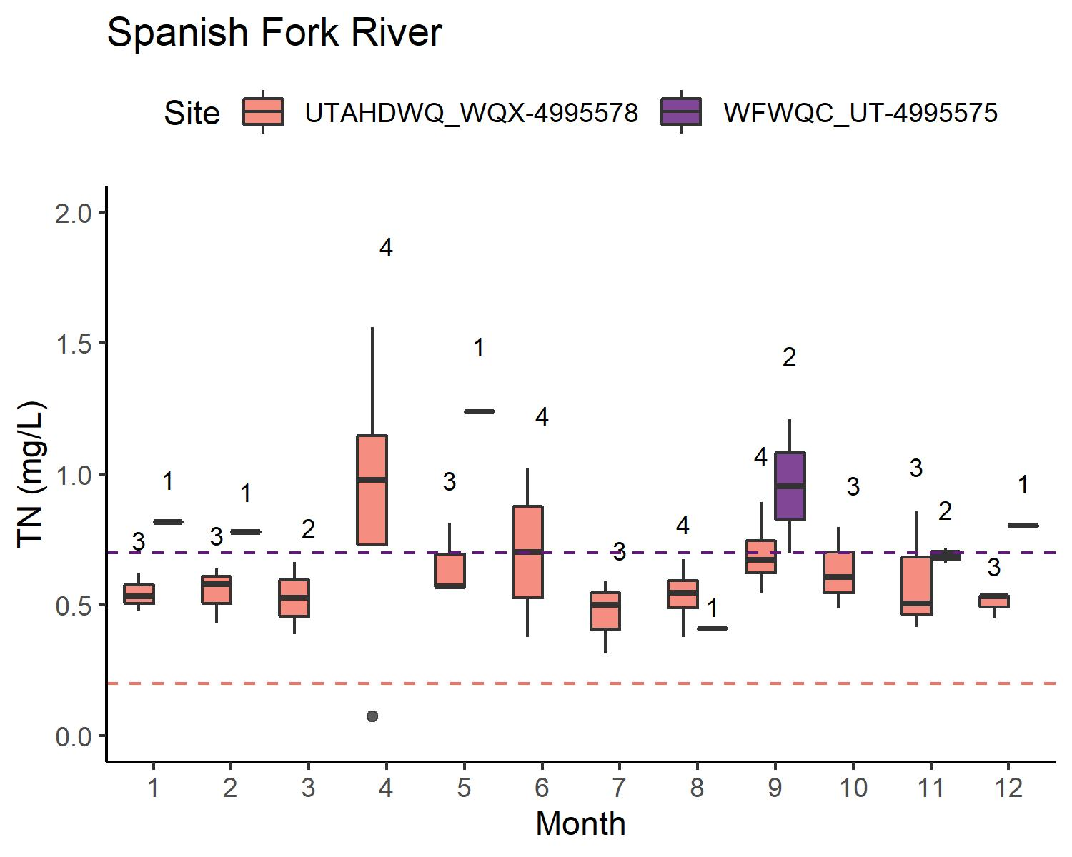
TN: WATERSHEDS W/O WWTP
Concentrations: typically equivalent or UDWQ < WFWQC
UDWQ generally has a more comprehensive sampling schedule than WFWQC
TN < WFWQC reporting limit for
Provo River
Hobble Creek
Spanish Fork River

Slide 11
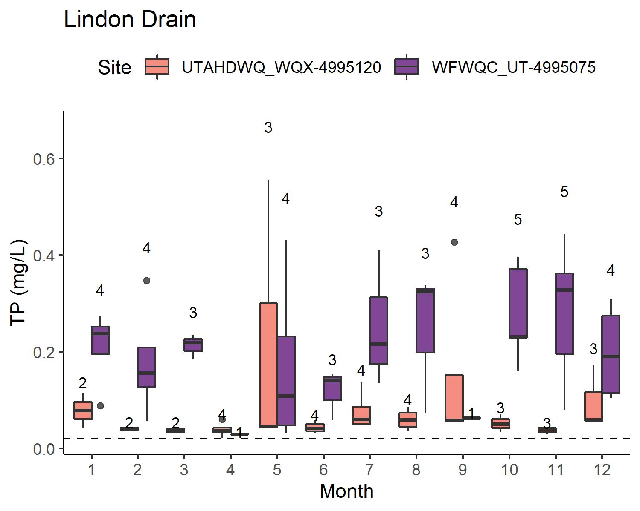
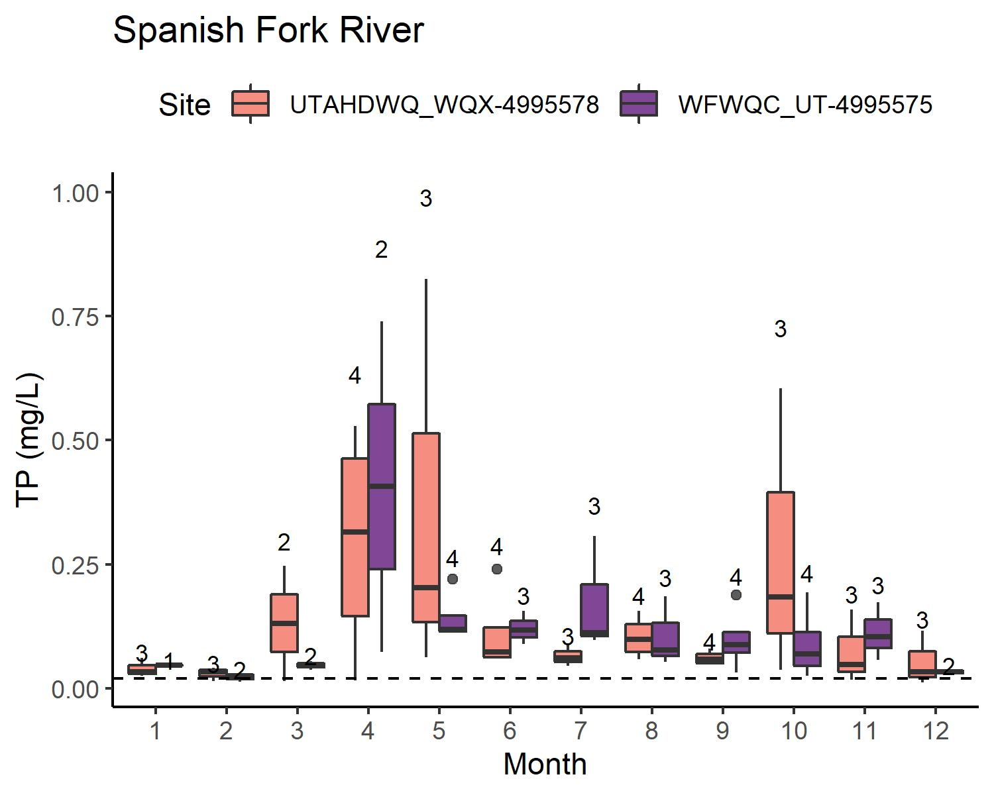
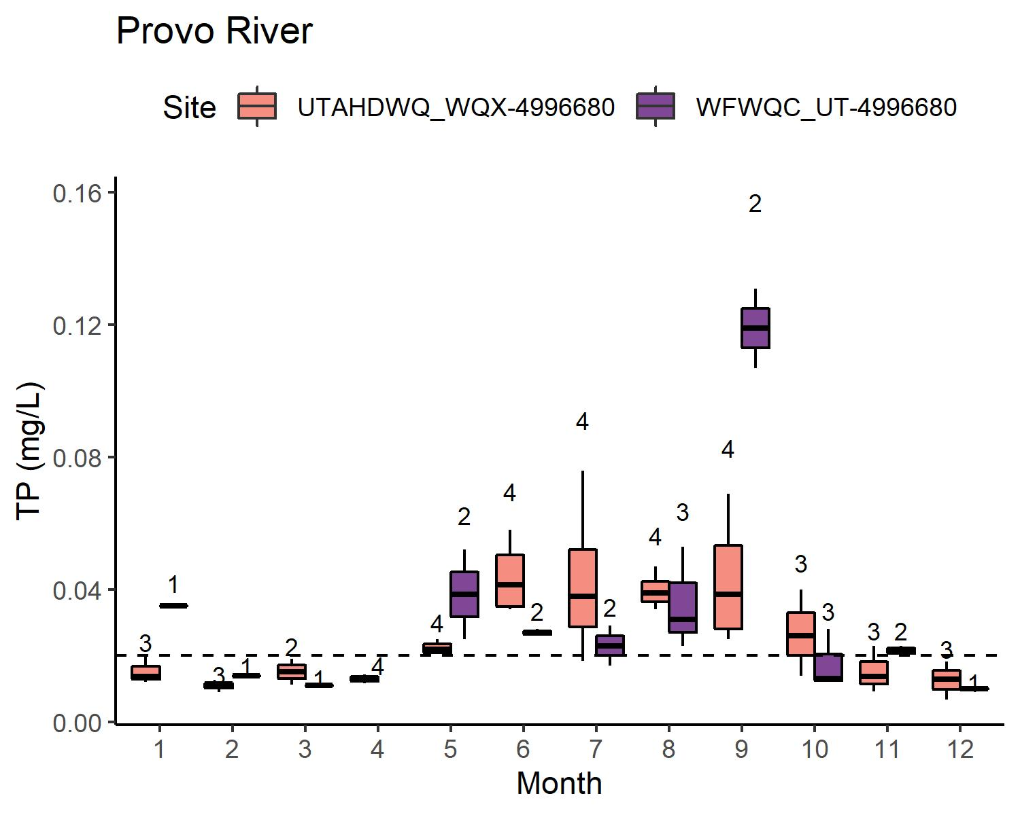
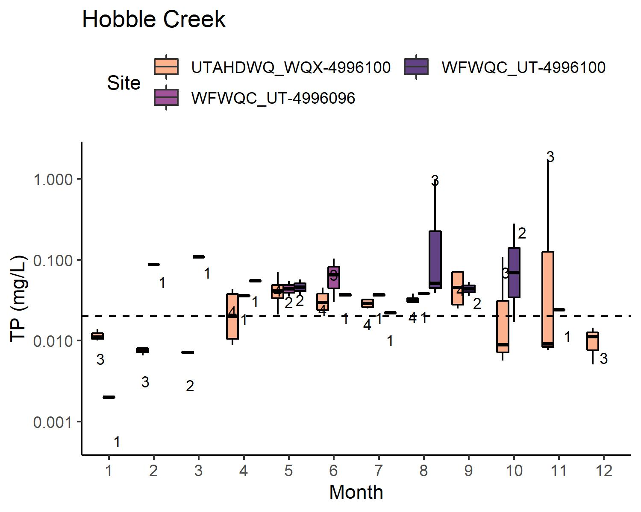
TP: WATERSHEDS W/O WWTP
Concentrations: typically equivalent or UDWQ < WFWQC
UDWQ generally has a more comprehensive sampling schedule than WFWQC
TP sometimes < reporting limit for
Provo River
Hobble Creek

Slide 12
WATERSHEDS W/ WWTP
Higher concentrations of nutrients → reporting limit likely not an issue
In some cases, multiple sites represent total load → direct comparison for UDWQ vs. WFWQC not as clear

Slide 13
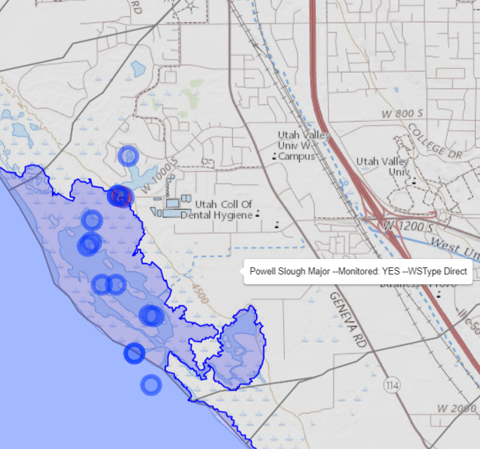
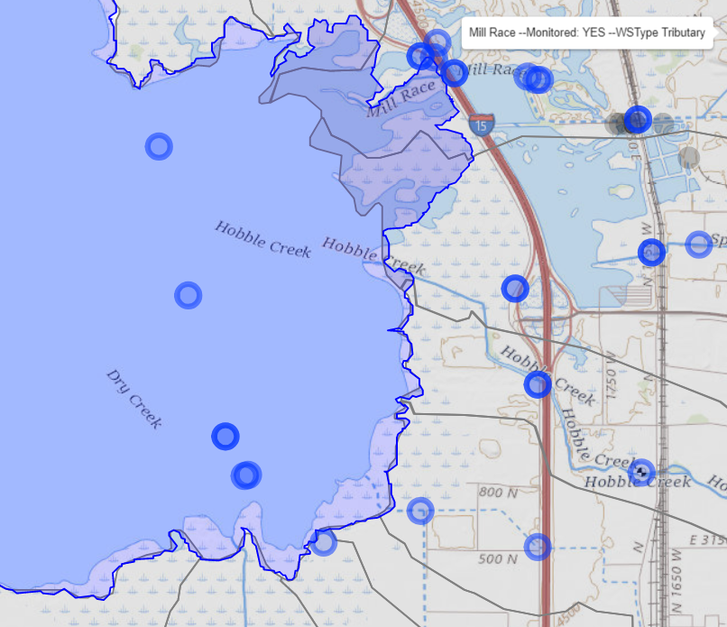
WATERSHEDS W/ WWTP
Downstream monitoring sites are below compromise elevation → limited data
Powell Slough
Mill Race
Dry Creek- Spanish Fork

Slide 14
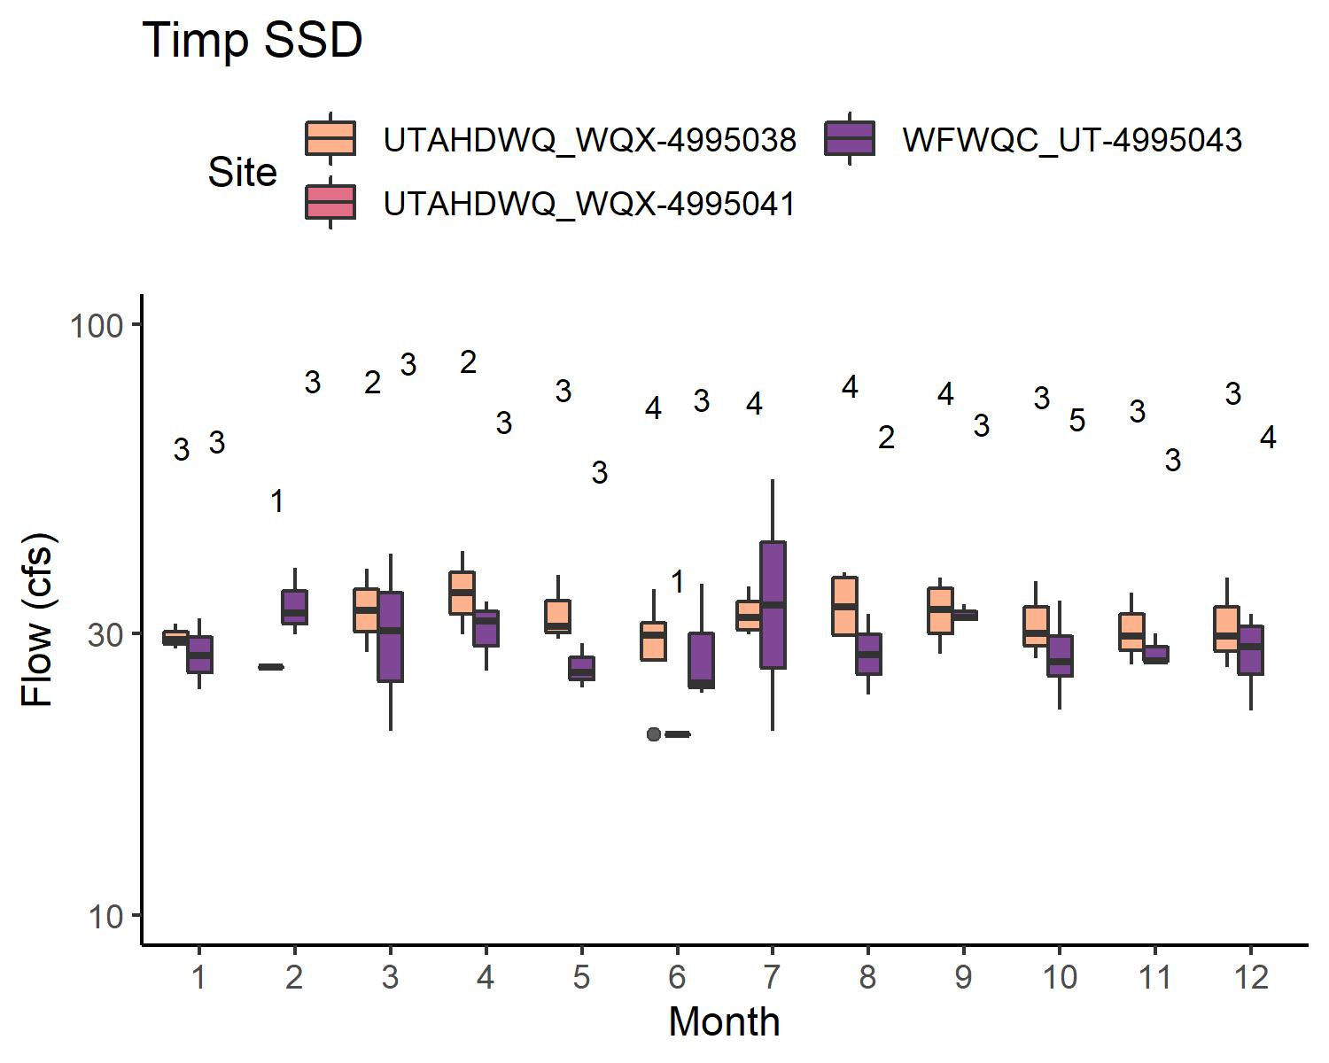
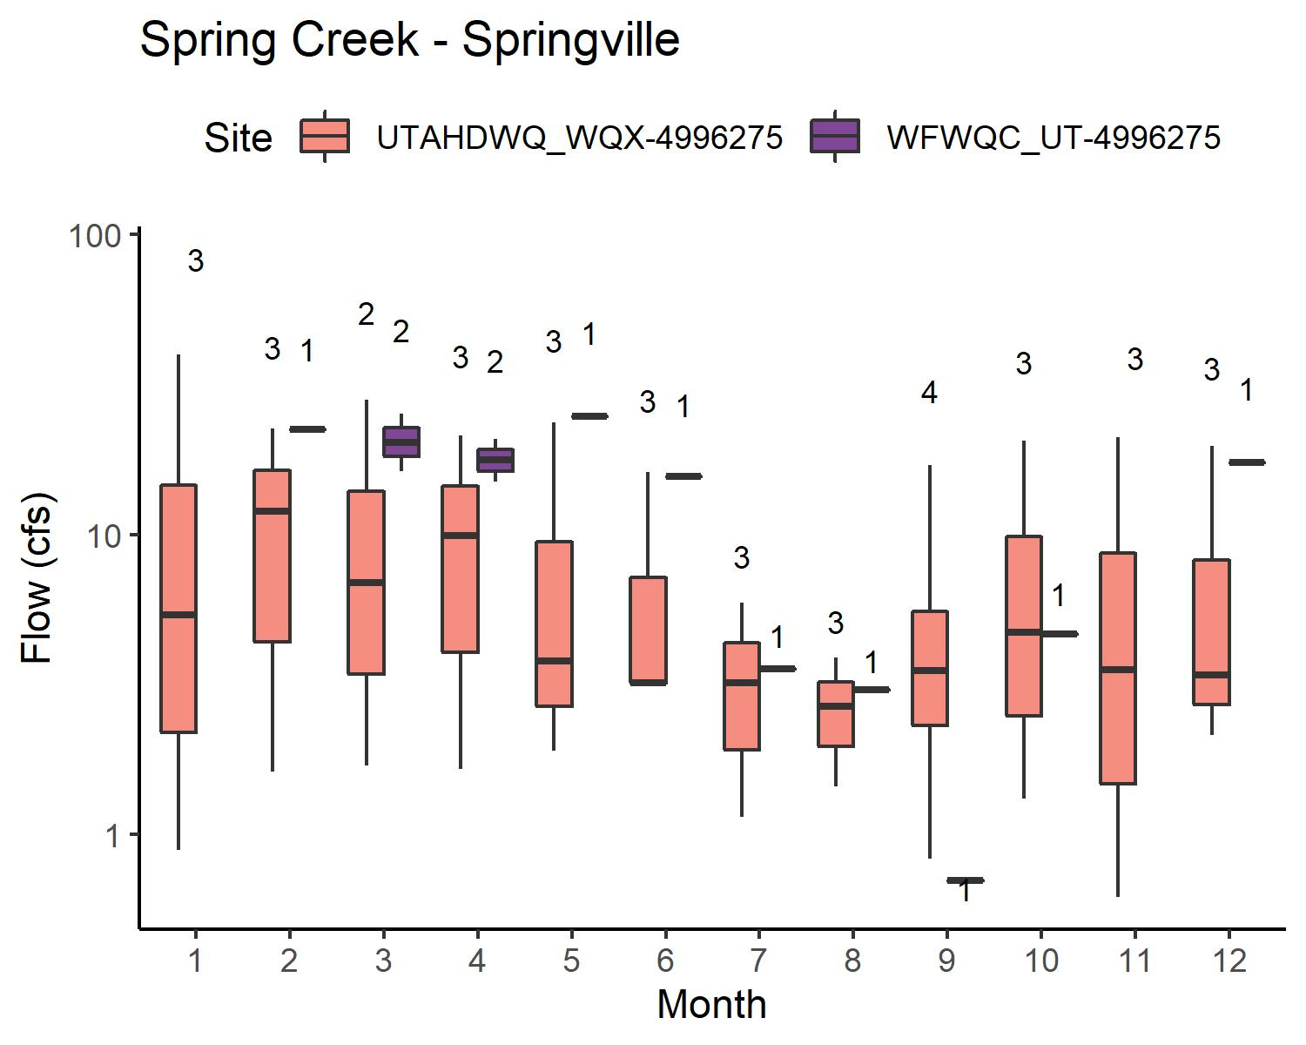
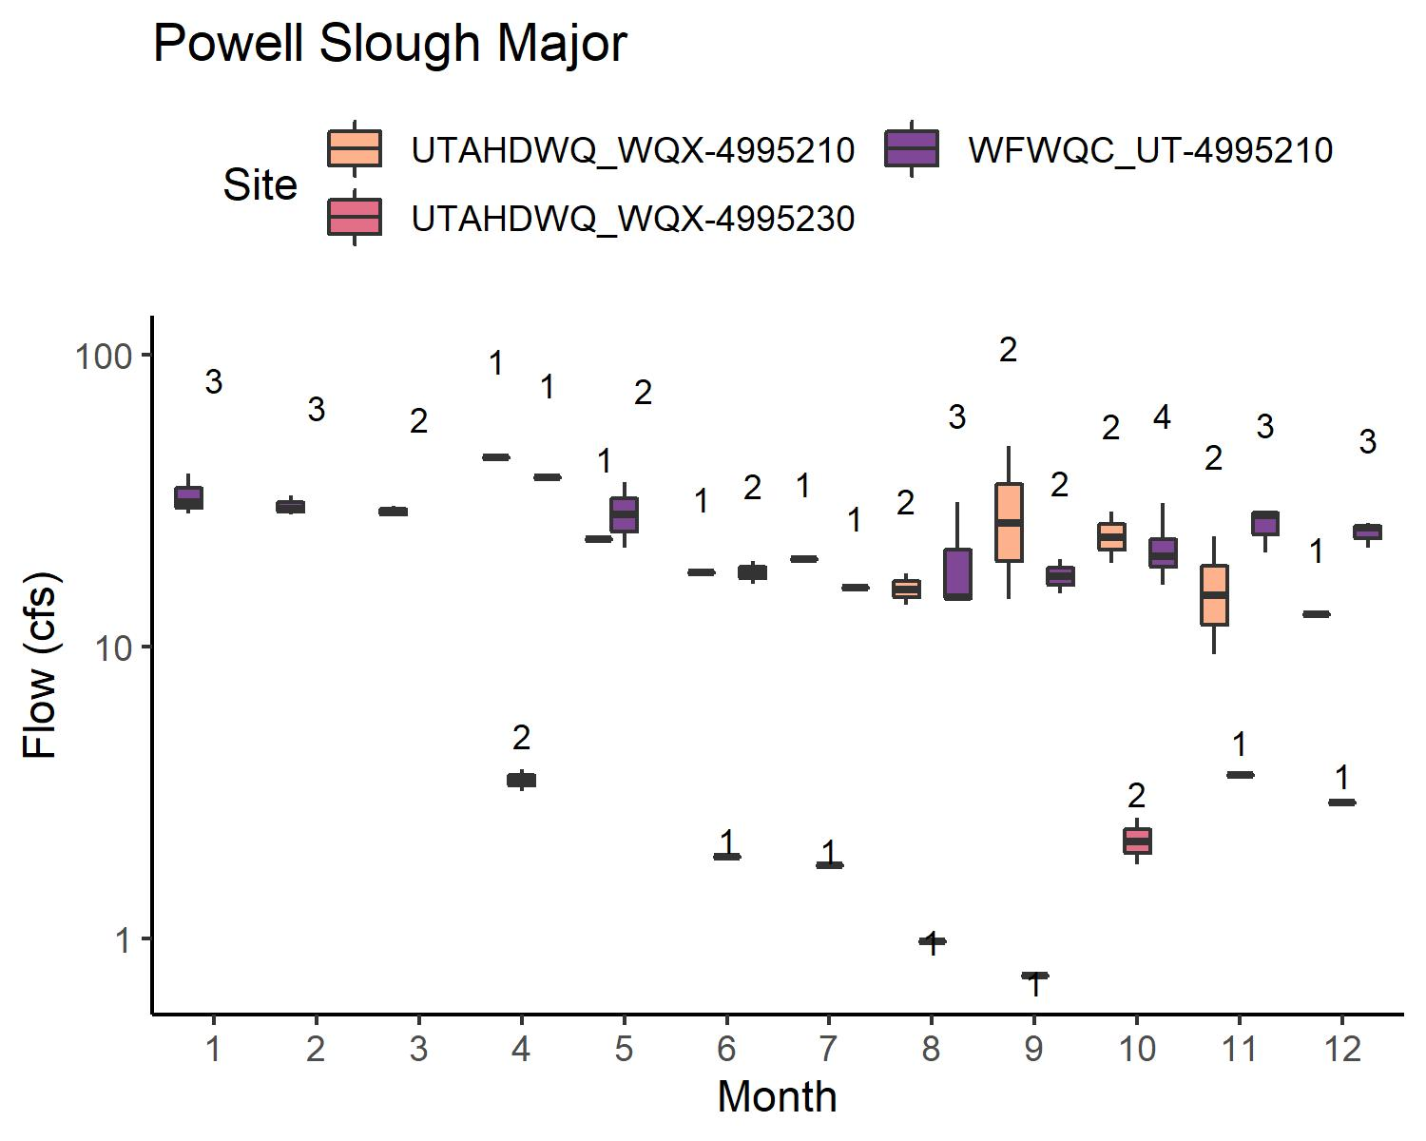
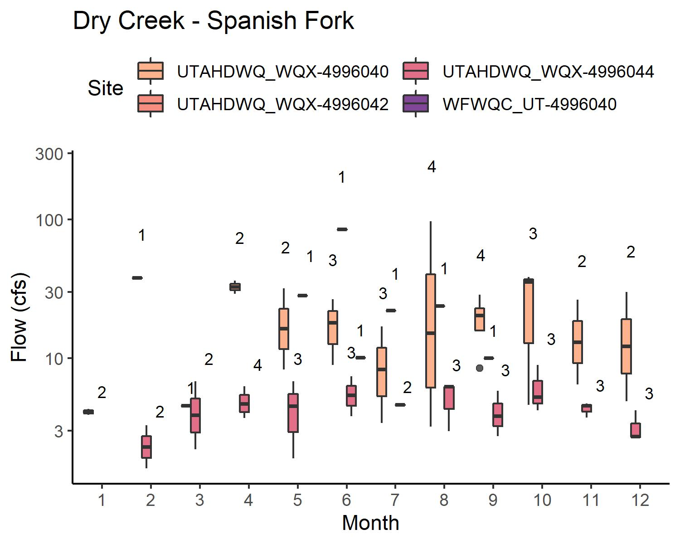
FLOW: WATERSHEDS W/ WWTP
Some sites are underwater sometimes → limited data
Data more limited for WFWQC sites than for UDWQ sites
Generally, flow is variable but comparable

Slide 15
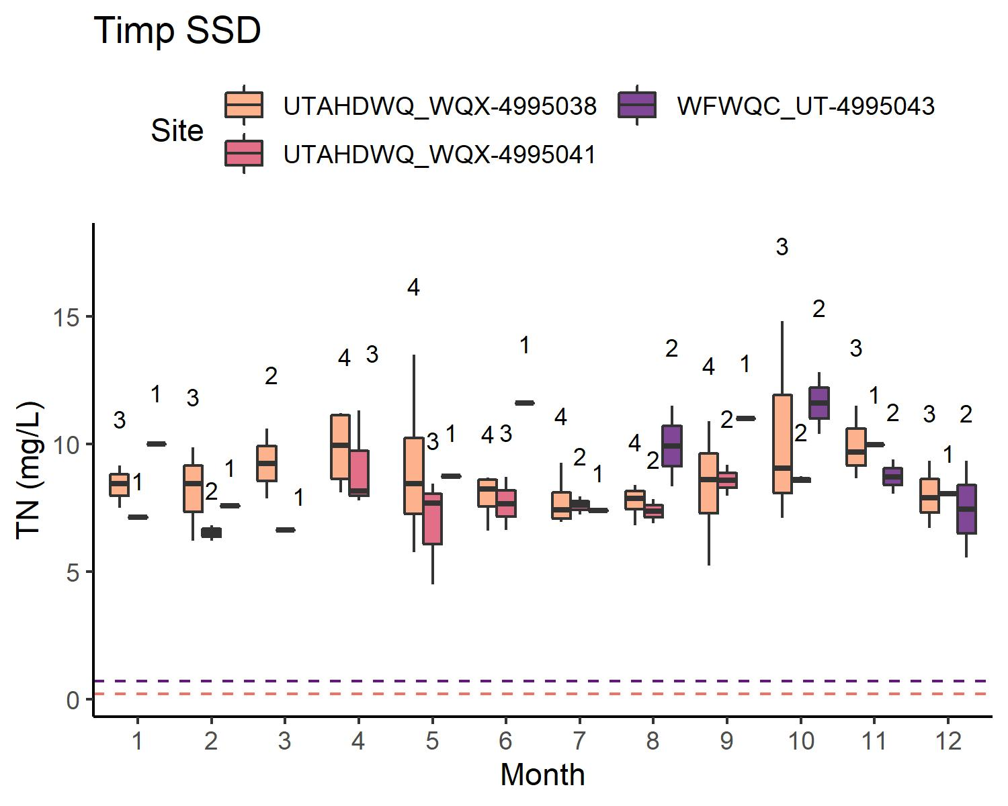
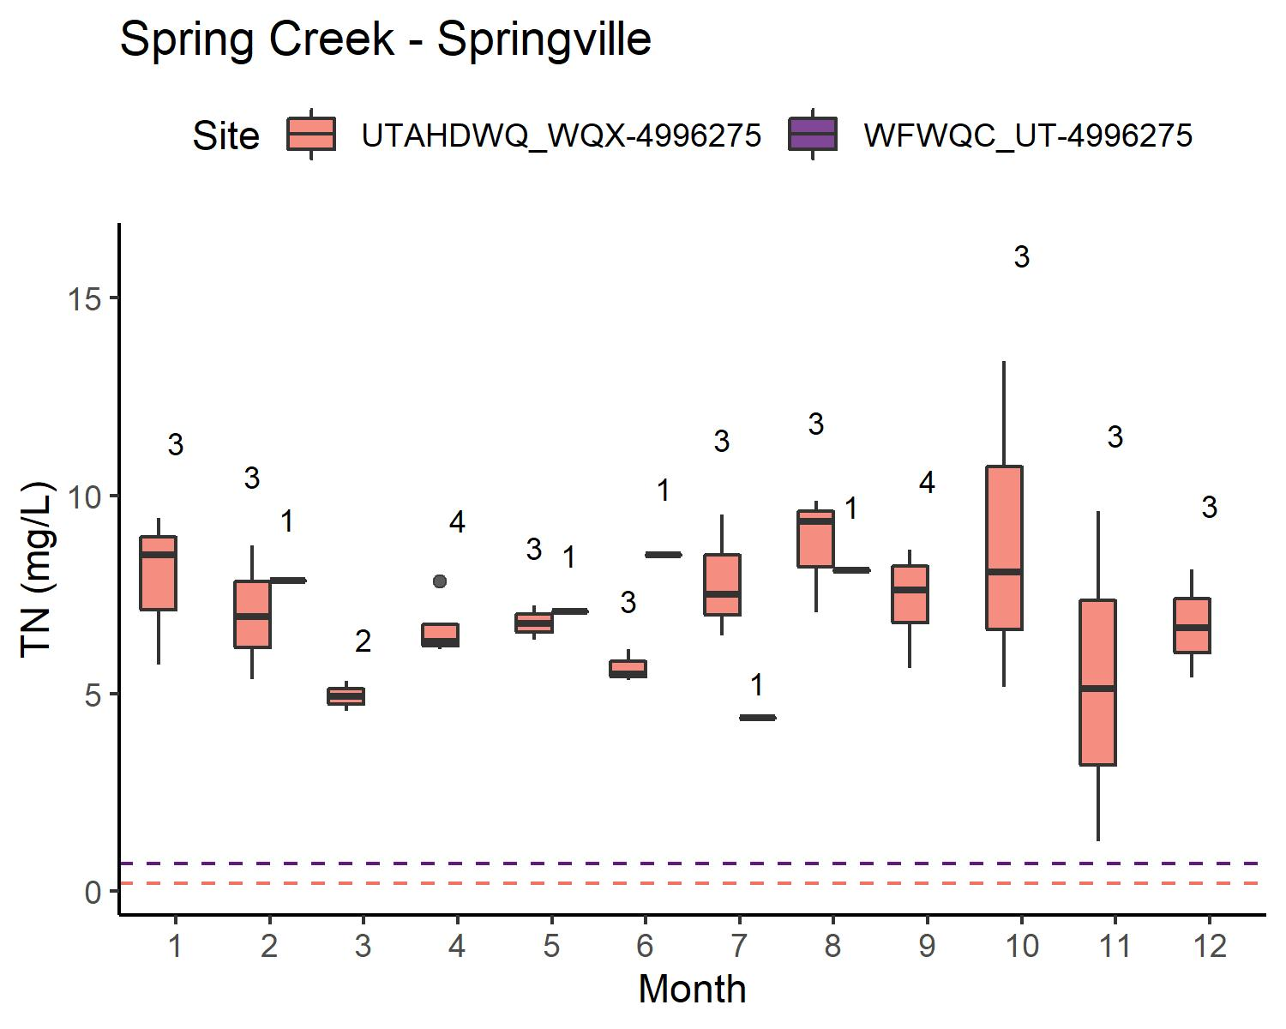
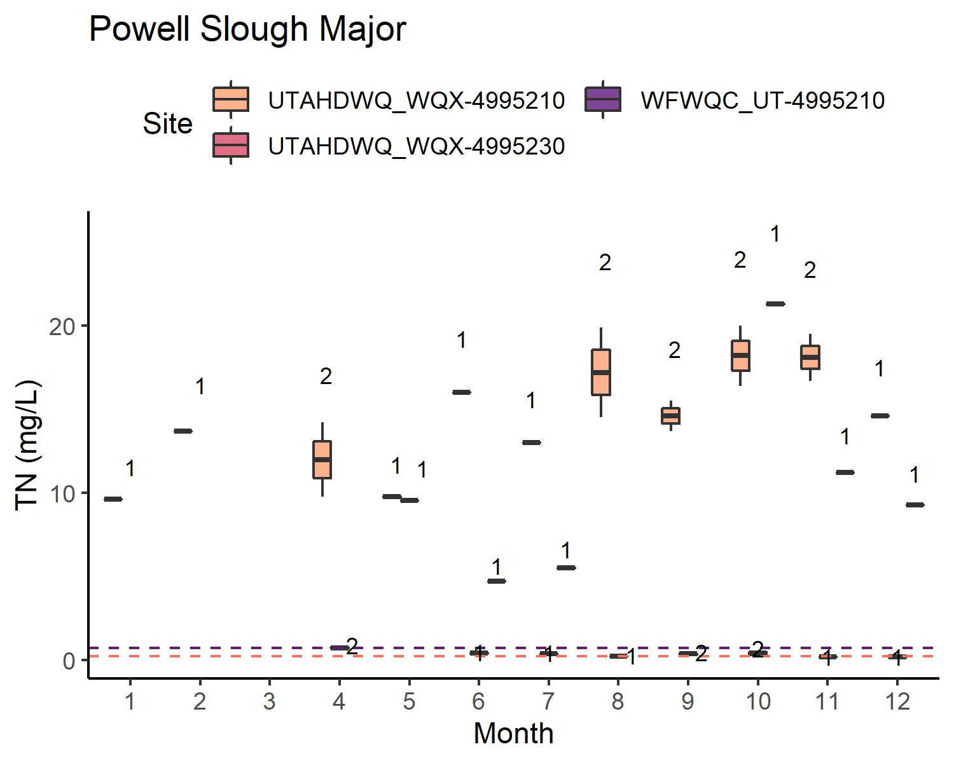
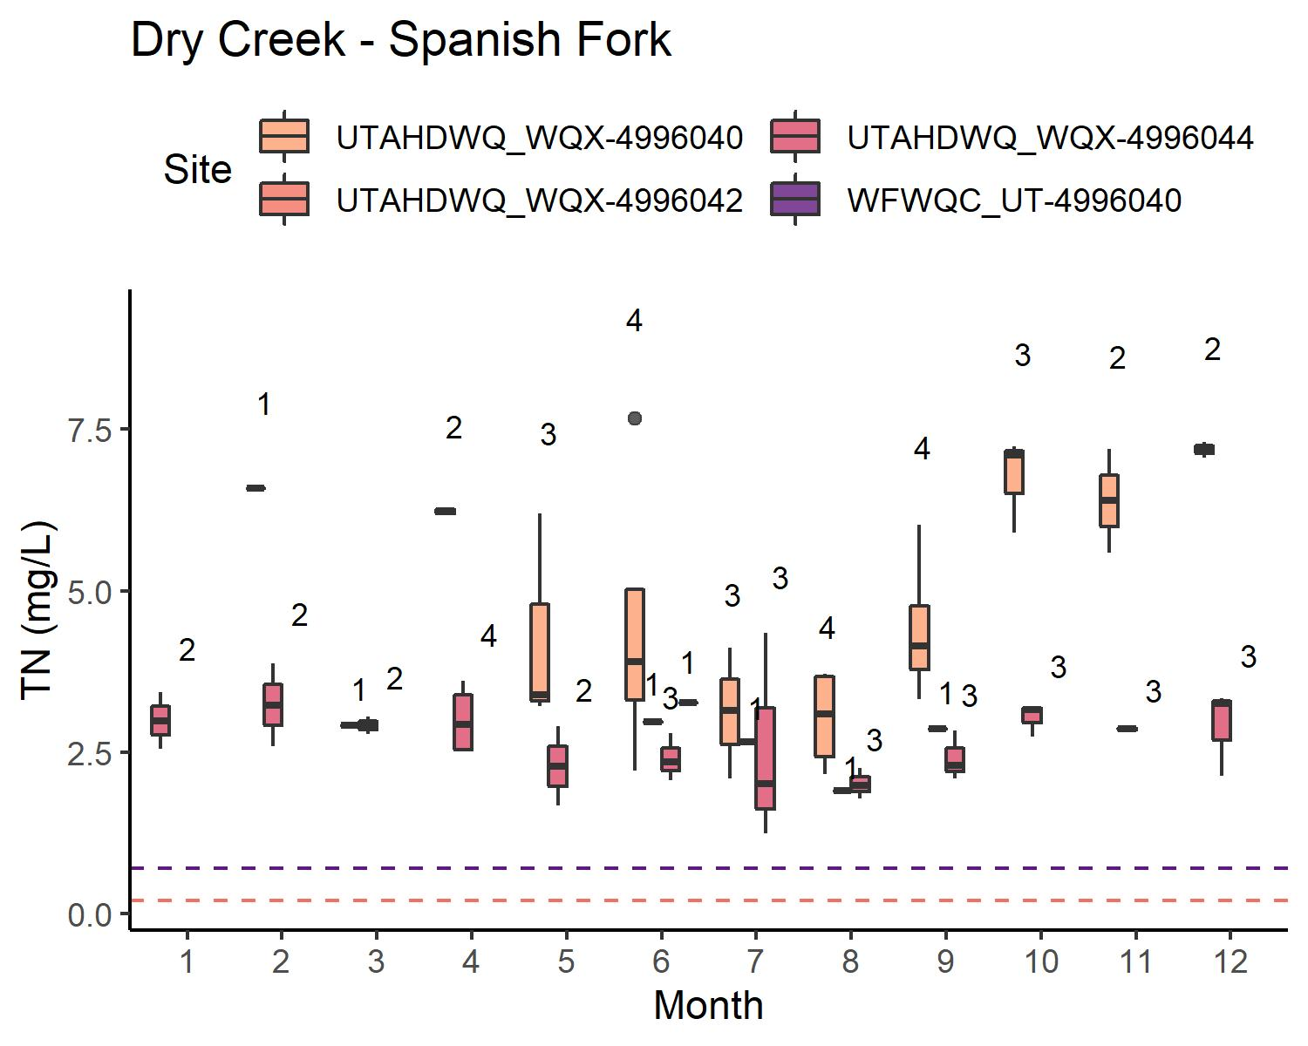
TN: WATERSHEDS W/ WWTP
Some sites are underwater sometimes → limited data
Data more limited for WFWQC sites than for UDWQ sites
Generally, concentrations are variable but comparable

Slide 16
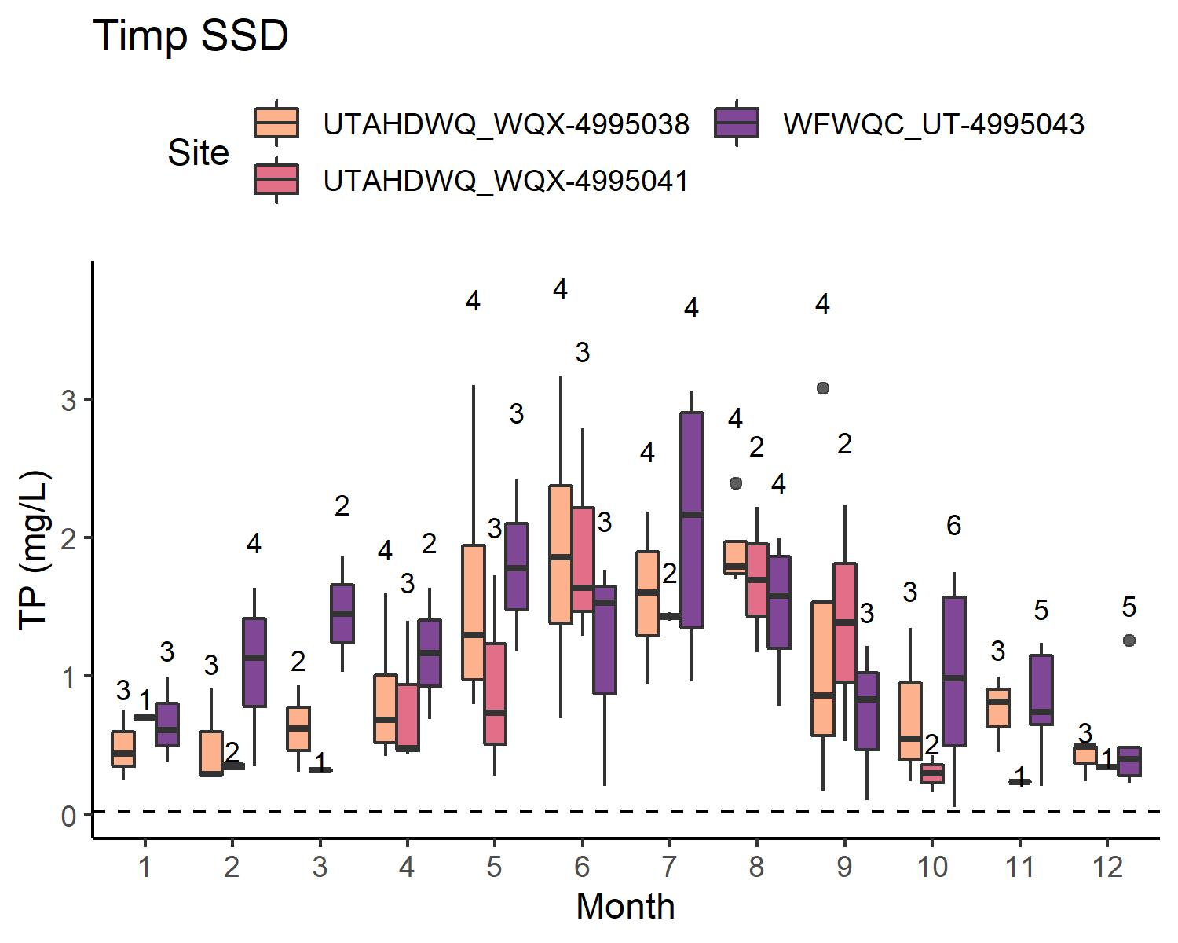
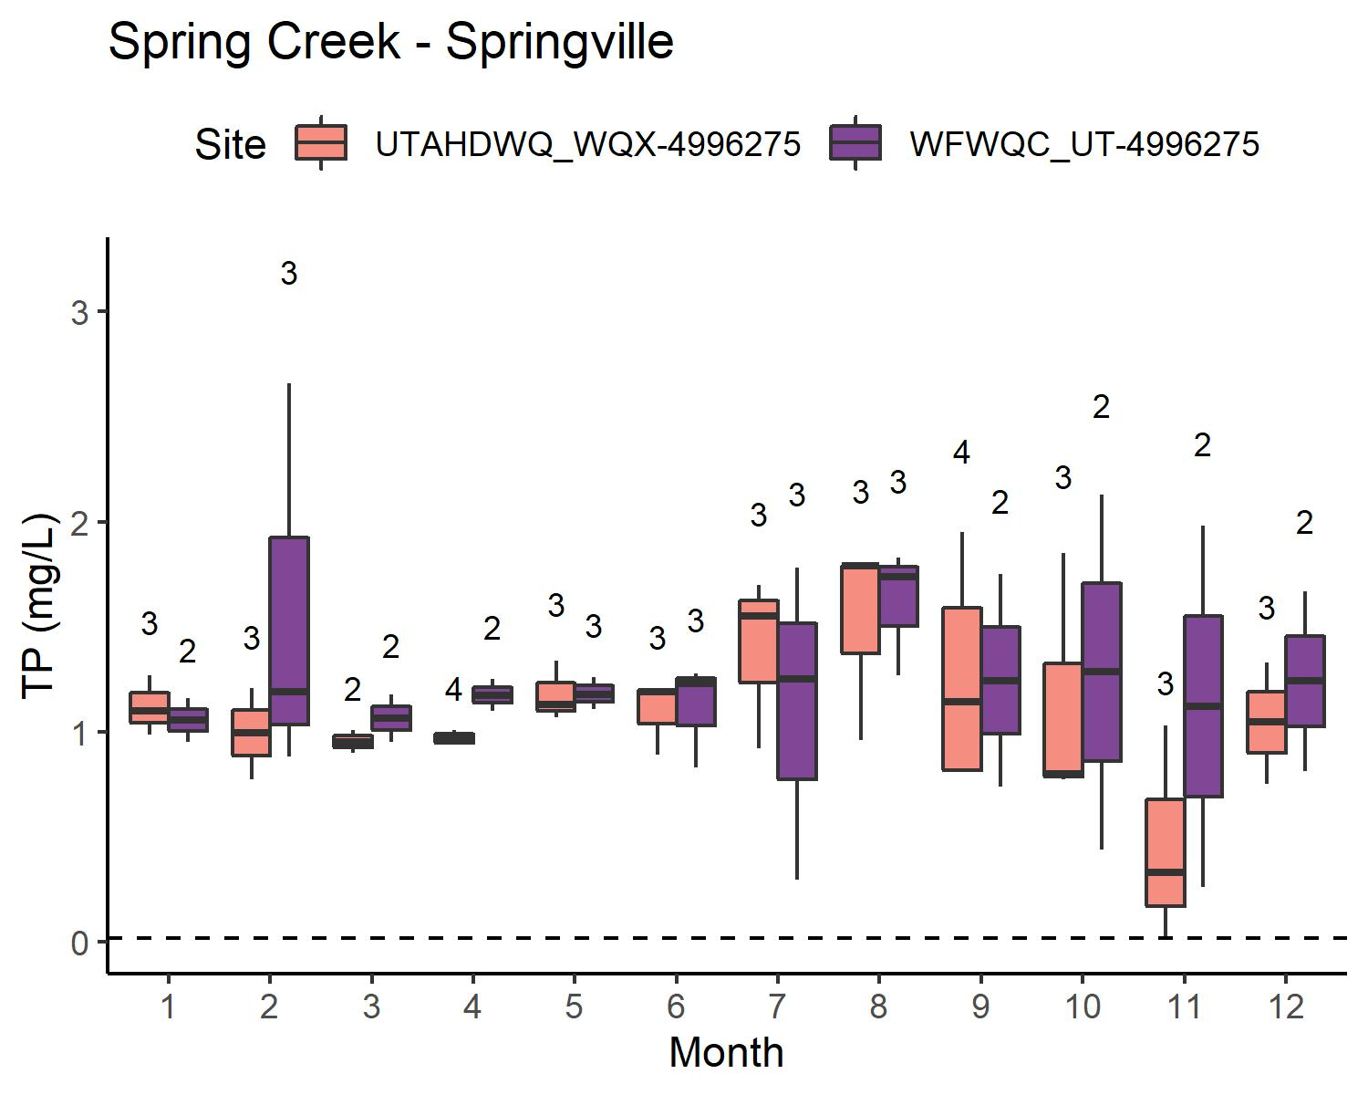
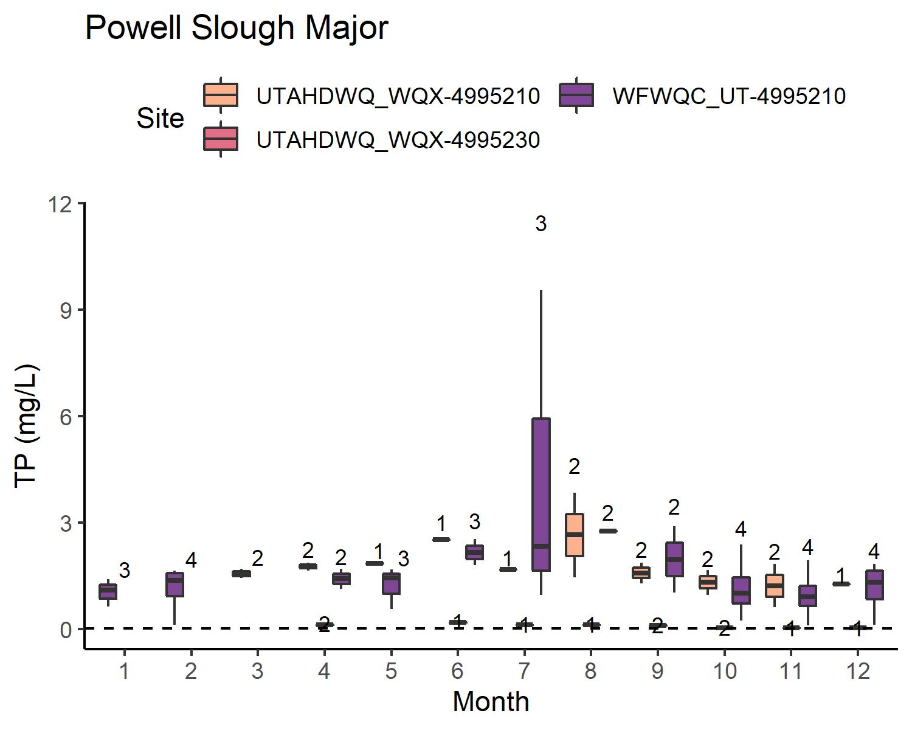
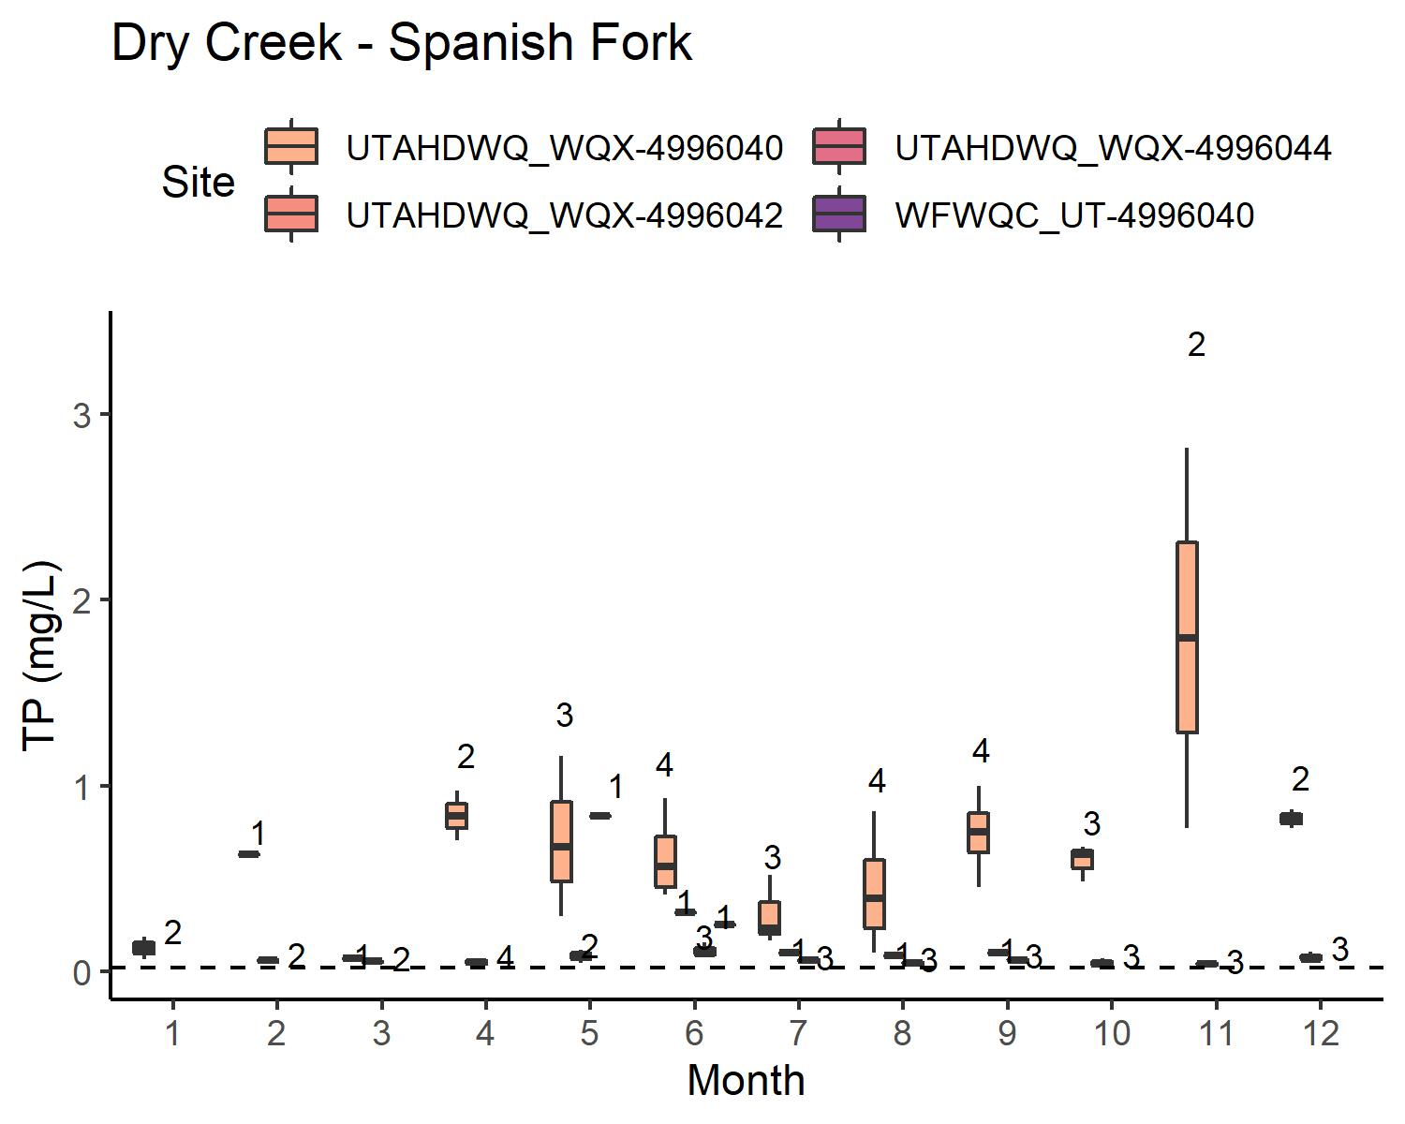
TP: WATERSHEDS W/ WWTP
Some sites are underwater sometimes → limited data
Data more limited for WFWQC sites than for UDWQ sites
Generally, concentrations are variable but comparable

Slide 17
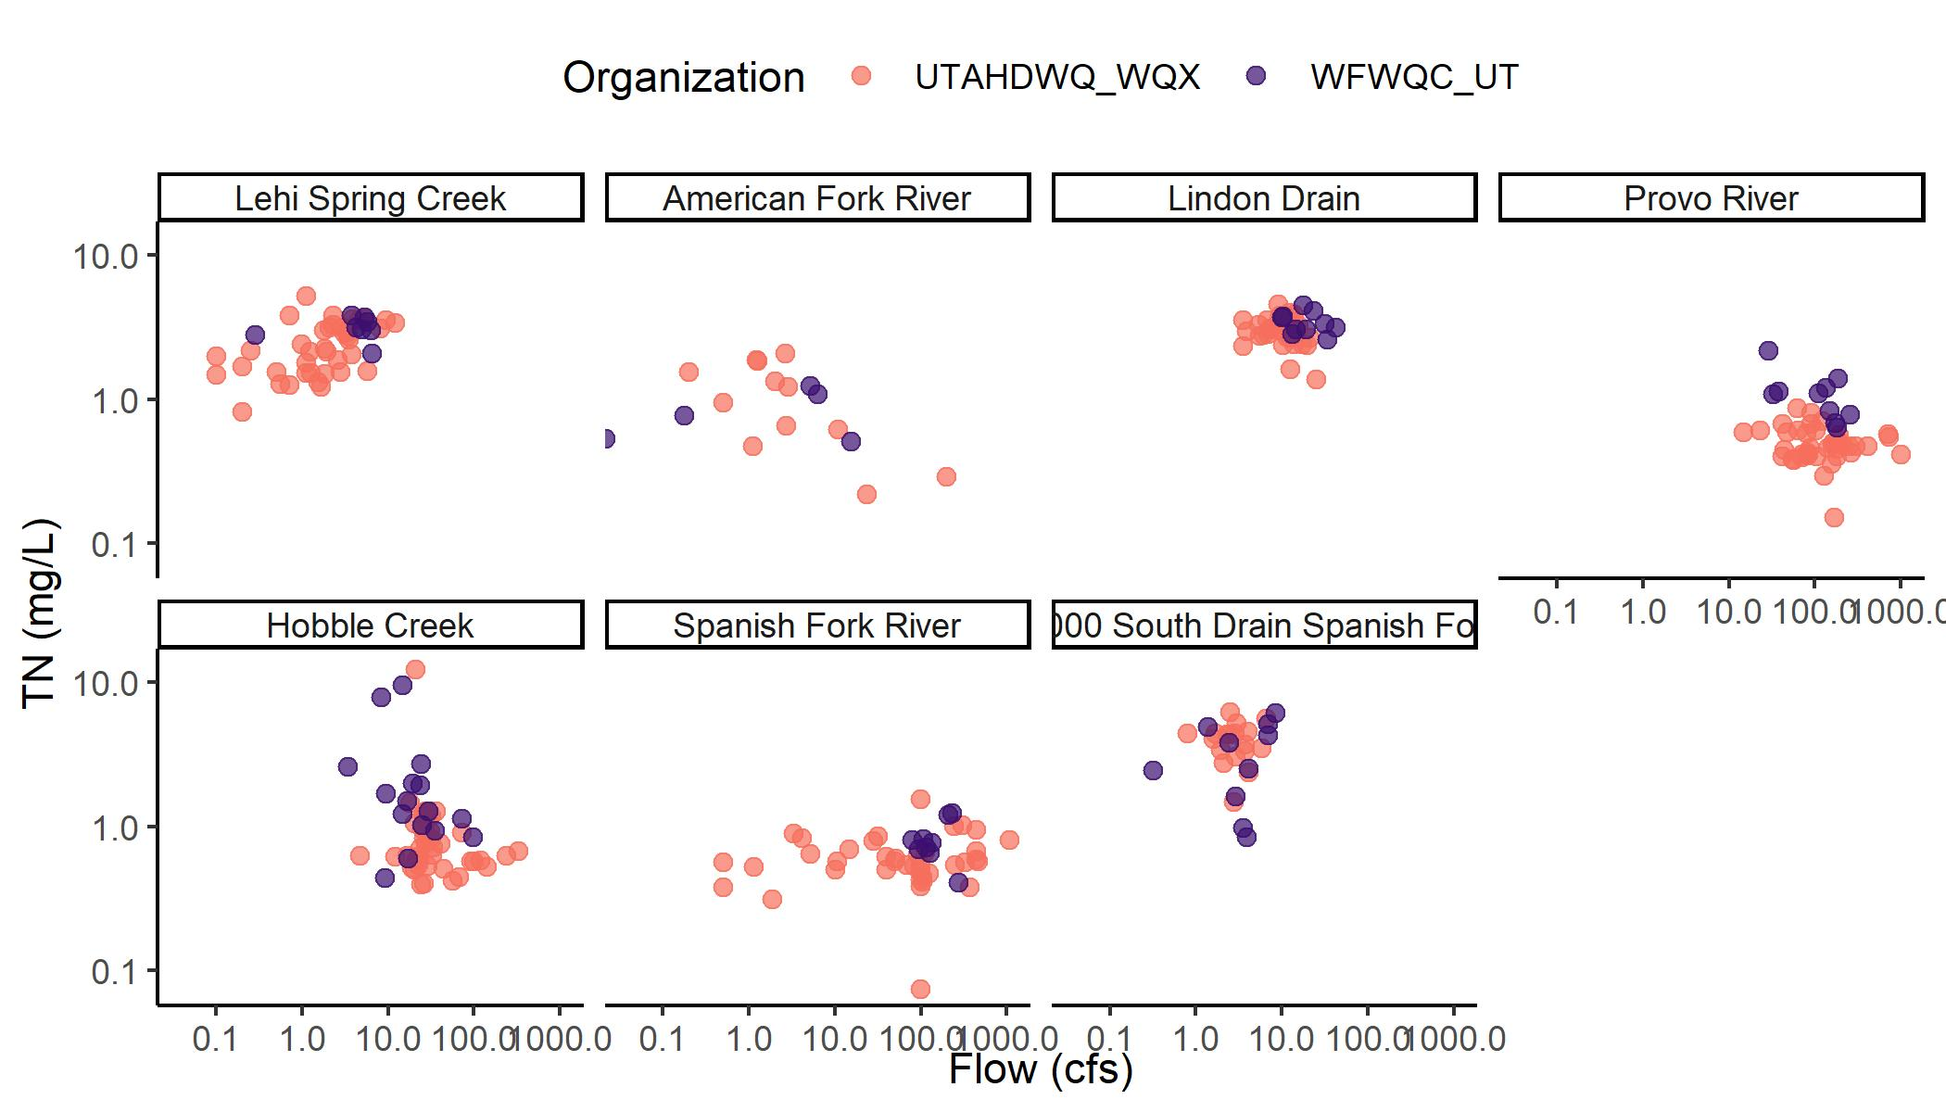
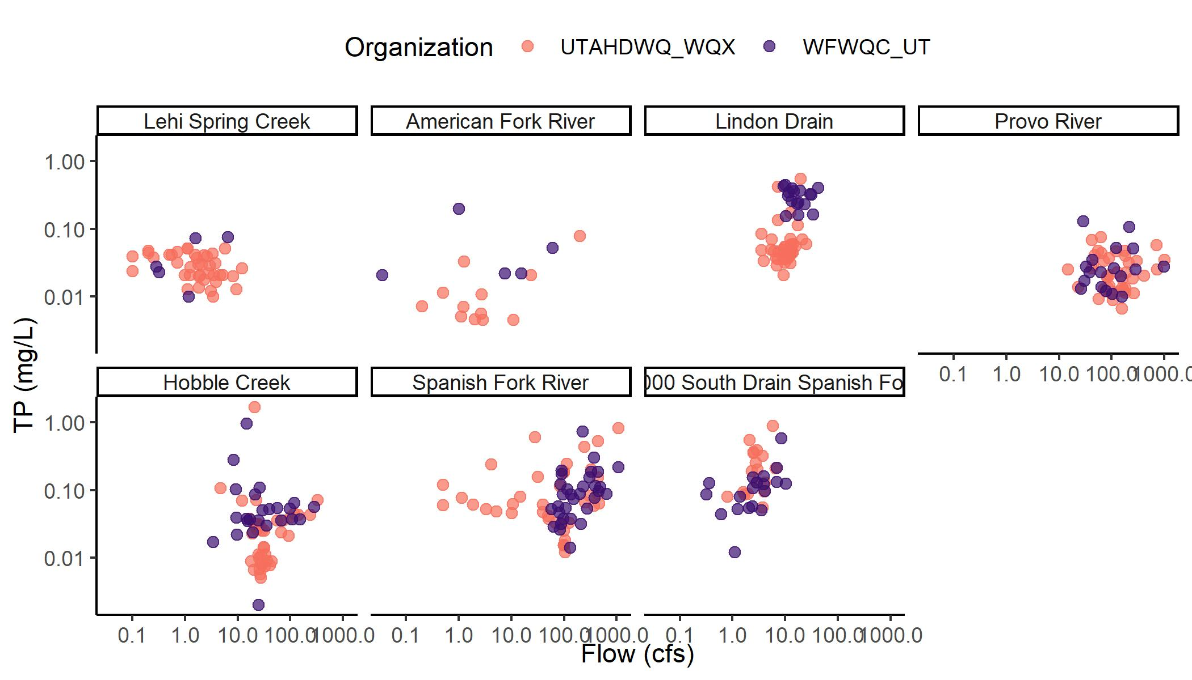
C-Q RELATIONSHIPS WATERSHEDS W/O WWTP
Watersheds w/ similar distributions
Hobble Creek
4000 South Drain Spanish Fork
Provo River (Q, TP)
Watersheds w/ truncated distribution for WFWQC
Lindon Drain
Spanish Fork River
Watersheds w/ few WFWQC samples
Lehi Spring Creek
American Fork River
Provo River (TN)
Spanish Fork River (TN)

Slide 18
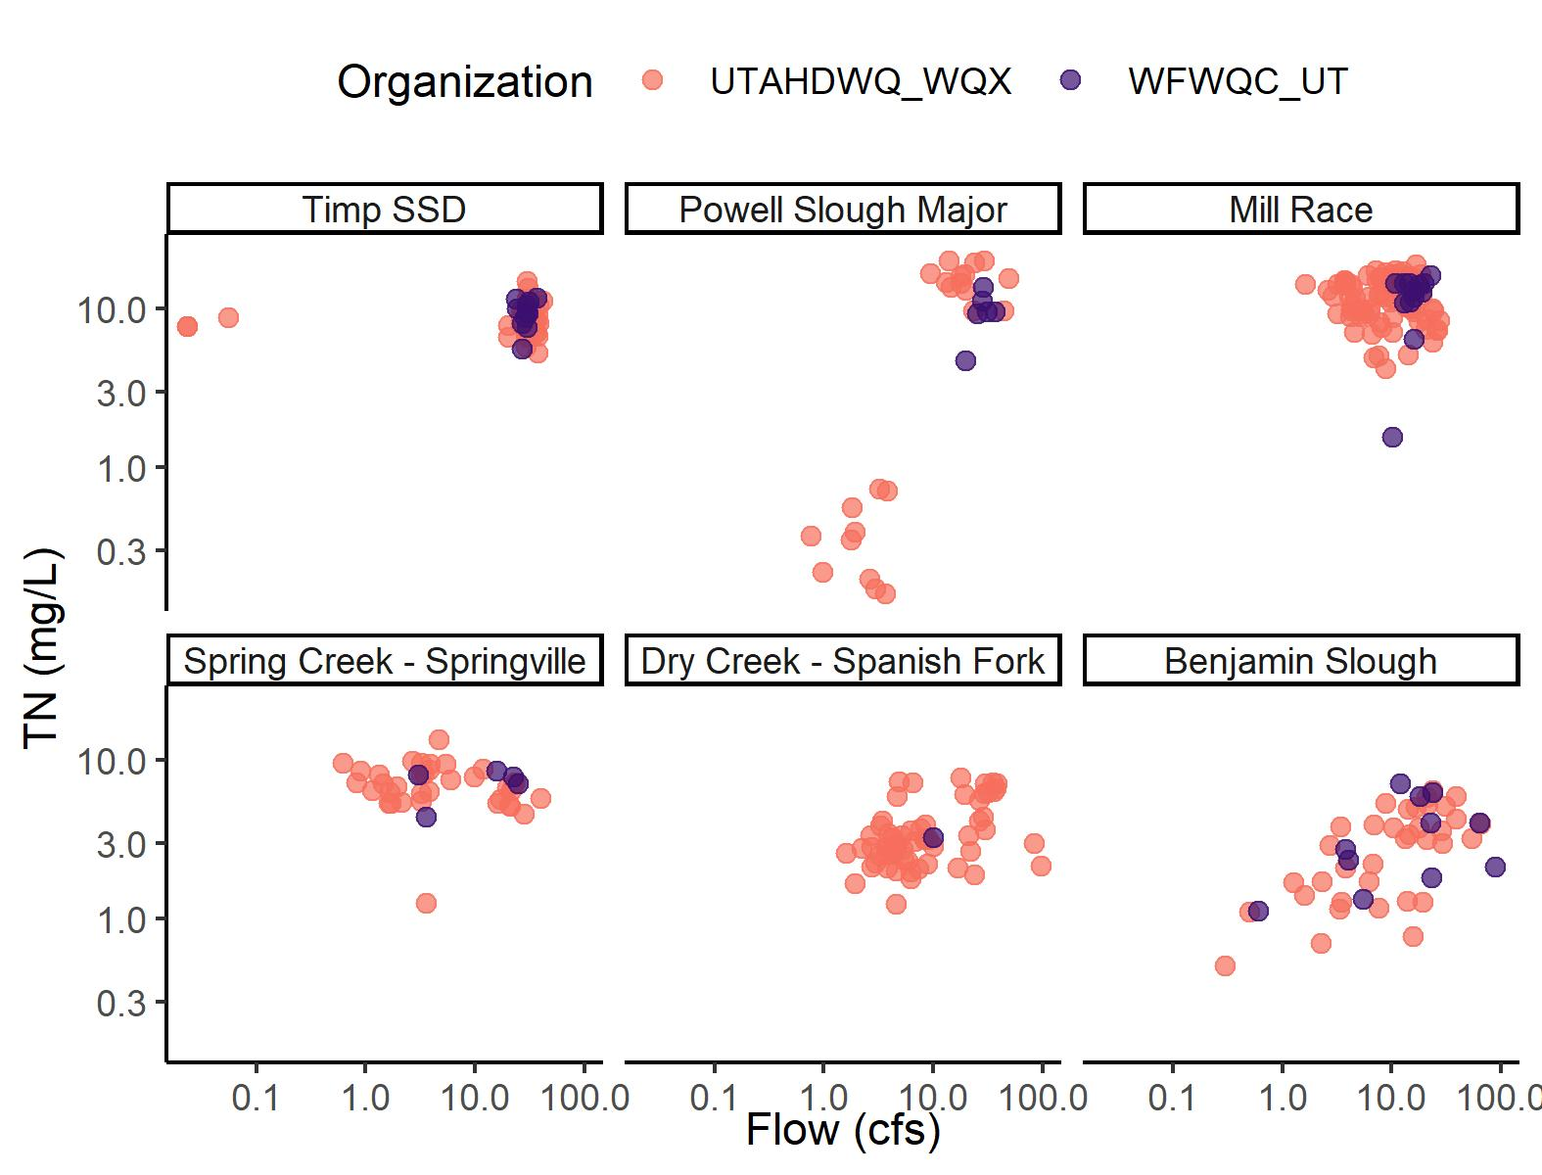
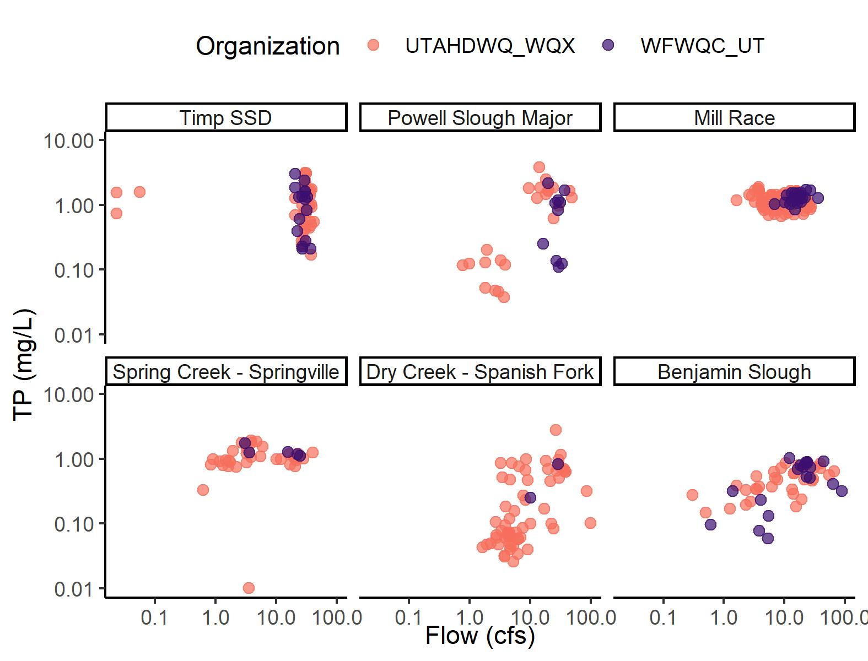
C-Q RELATIONSHIPS WATERSHEDS W/ WWTP
Watersheds w/ similar distributions
Timp SSD
Benjamin Slough
Watersheds w/ truncated distribution for WFWQC
Powell Slough Major
Watersheds w/ few WFWQC samples
Powell Slough Major
Mill Race
Spring Creek – Springville
Dry Creek – Spanish Fork

Slide 19
TAKEAWAYS: COMPARISON OF UDWQ AND WFWQC MONITORING
Reporting limit is an issue for WFWQC samples in watersheds w/o WWTP
UDWQ sampling is more comprehensive than WFWQC for some watersheds
Concentrations and flows are often, but not always equivalent → discrepancies could be a function of bias or limited sampling
SAP and/or QAPP not available for WFWQC flow estimates
Recommend moving forward with UDWQ data. Choices:
Incorporate WFWQC data and use measurements regardless of entity
Exclude WFWQC data

Slide 20
ADDITIONAL QUESTIONS
What to do for months missing data? (≠ months w/ zero flow)
→ suggest inserting load from nearest month (linear or piecewise constant interpolation)

Slide 22
EXTERNAL MASS BALANCE: DECISION POINTS
Focus today: tributary loads in monitored watersheds
2 Decision points:
Comparing DWQ and WFWQC data → using one or both entities
For watersheds with WWTP, how to address DMR reported loads vs. tributary data?
When DMR load > tributary load, compare flow volumes to evaluate potential infiltration sink
When tributary site is below compromise, consider using DMR data as definitive loading (even if attenuation happens, that “loss” is incorporated into the lake ecosystem when water rises)

